Slide 1
Memory-based FFT
SEUNGWAN NOH

Slide 2
Contents
Fast Fourier Transform
Block RAM/ROM
FFT Implementations
SPBRAM
Simple DPBRAM
True DPBRAM

Slide 3
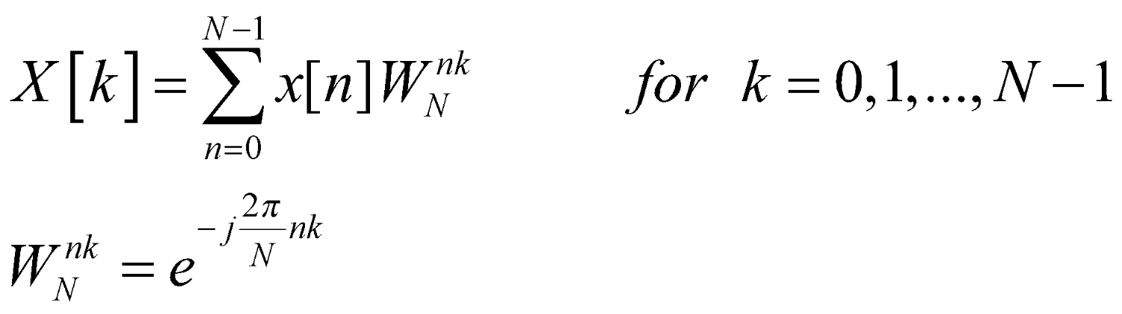
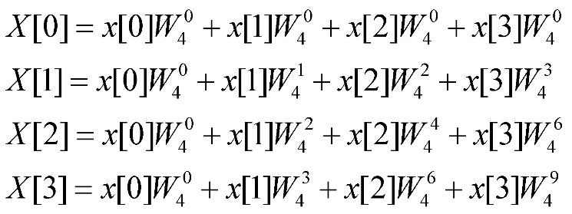
FFT
DFT(Discrete Fourier Transform)
Computation of DFT
N=4
16 Complex Multiplication
12 Complex Addition
Notes:
FFT 알고리즘 내용 보충

Slide 4
FFT
Computation of DFT
N | # of Multiplication | # of Addition
4 | 16 | 12
8 | 64 | 56
16 | 256 | 240
64 | 1024 | 992
N | N² | N(N-1)

Slide 5
FFT
FFT(Fast Fourier Transform)
FFT is an algorithm used to efficiently compute DFT.
FFT reduces the number of operations to compute DFT.
Cooley-Tuckey Algorithm
James Cooley and John Tuckey in 1965
Reducing the computational complexity from N² to NlogN
“Divide and Conquer”
Periodicity and symmetry of DFT

Slide 6
Cooley-Tuckey Algorithm
DIT(Decimation in Time)
Partitioning the sequence in time.
Divide the original sequence into even and odd-indexed.
DIT algorithm essentially reorders the sequence in bit-reversed manner as part of its process.
DIF(Decimation in Frequency)
Partitioning the sequence in frequency.
Computing the DFT outputs and decimating them into even and odd components.
Involves rearrangement of the output sequence.
Radix-2 Algorithm
Applicable when the length of the sequence is power of two.
Divide DFT computation into two parts at each stage.

Slide 7
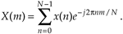
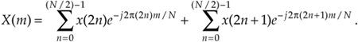
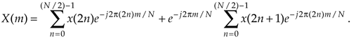
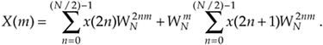
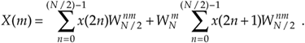
Cooley-Tuckey Algorithm
Derivation of the DIT Radix-2 FFT Algorithm
DFT
Break into two parts

Slide 8
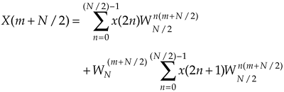
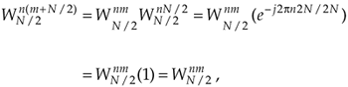
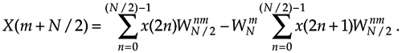
Cooley-Tuckey Algorithm
Derivation of the DIT Radix-2 FFT Algorithms
Upper half of the DFT outputs

Slide 9
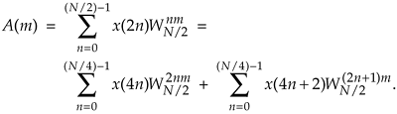
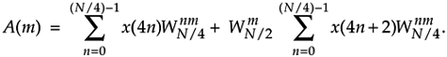
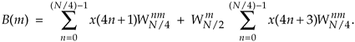
Cooley-Tuckey Algorithm
Derivation of the DIT Radix-2 FFT Algorithms
Simplify the equations

Slide 10
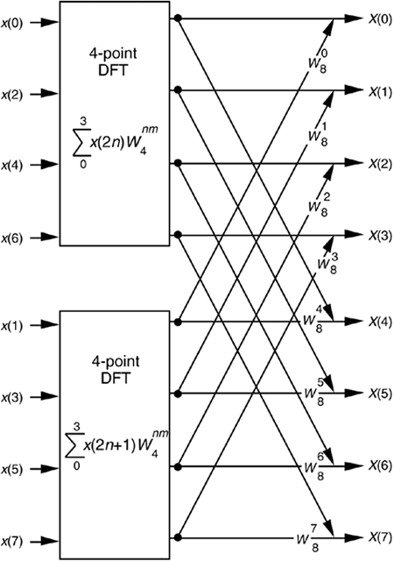
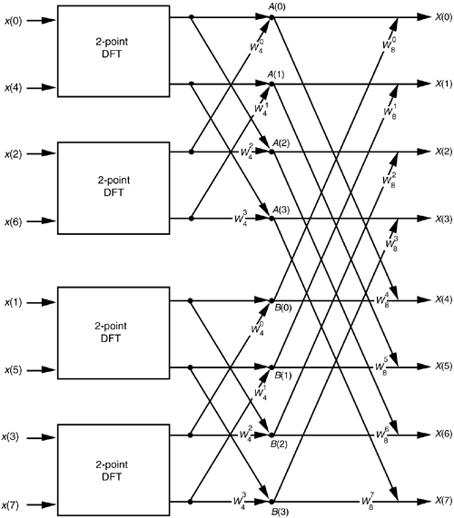
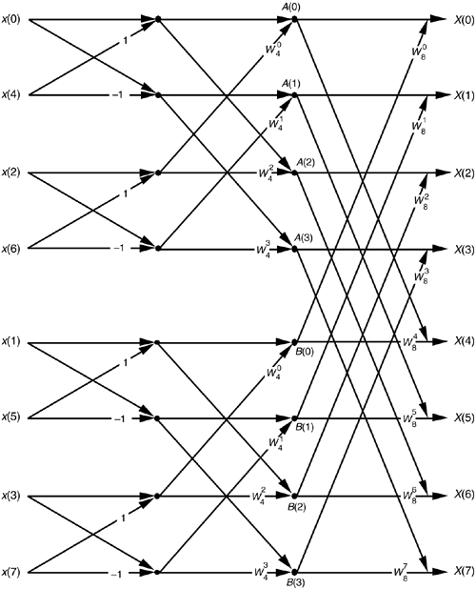
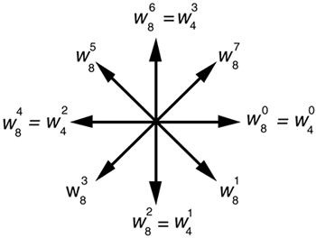
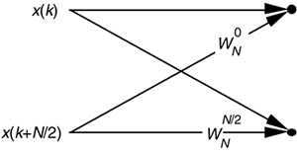
Cooley-Tuckey Algorithm
Radix-2 8pt DIT FFT SFG

Slide 11
Cooley-Tuckey Algorithm
DIF
Natural order input >> Bit-reversal output
DIT
Bit-reversal input >> Natural order output

Slide 12
Block RAM/ROM
Single-port
Has one access port, read or write data in one cycle.
Sequential access, low throughput
Enhance efficiency, reduce area, and minimize power.
Dual-port Memory
Has two access ports, simultaneous read and write.
High throughput
More complex and expensive.
Require more complex access control

Slide 13
Memory-based FFT
MBFFT
BRAM |  | SPBRAM |  | Simple DPBRAM | True DPBRAM
Point | 16pt |  | 64pt | 16pt | 16pt
LUT | 184 |  | 234 | 255 | 291
FF | 119 |  | 126 | 222 | 56
BRAM | 2 |  | 2 | 2.50 | 3.50
DSP | 4 |  | 4 | 4 | 4
IO | 69 |  | 69 | 69 | 133
BUFG | 1 |  | 1 | 1 | 1
WNS(ns) | 6.566 |  | 7.055 | 7.101 | 8.136
WHS(ns) | 0.217 |  | 0.131 | 1.63 | 0.177
Power(W) | 0.119 |  | 0.12 | 0.122 | 0.13

Slide 14
SPBRAM FFT

Slide 15
SPBRAM
SPBRAM
Block Diagram
Timing Diagram
Radix-2 16pt DIT MBFFT
Simulation Results
Reusable Design

Slide 16
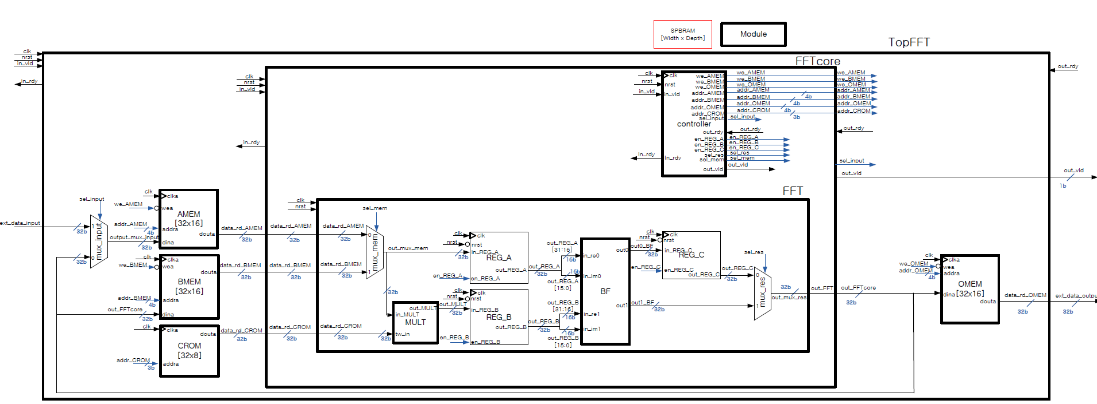
Block Diagram

Slide 17
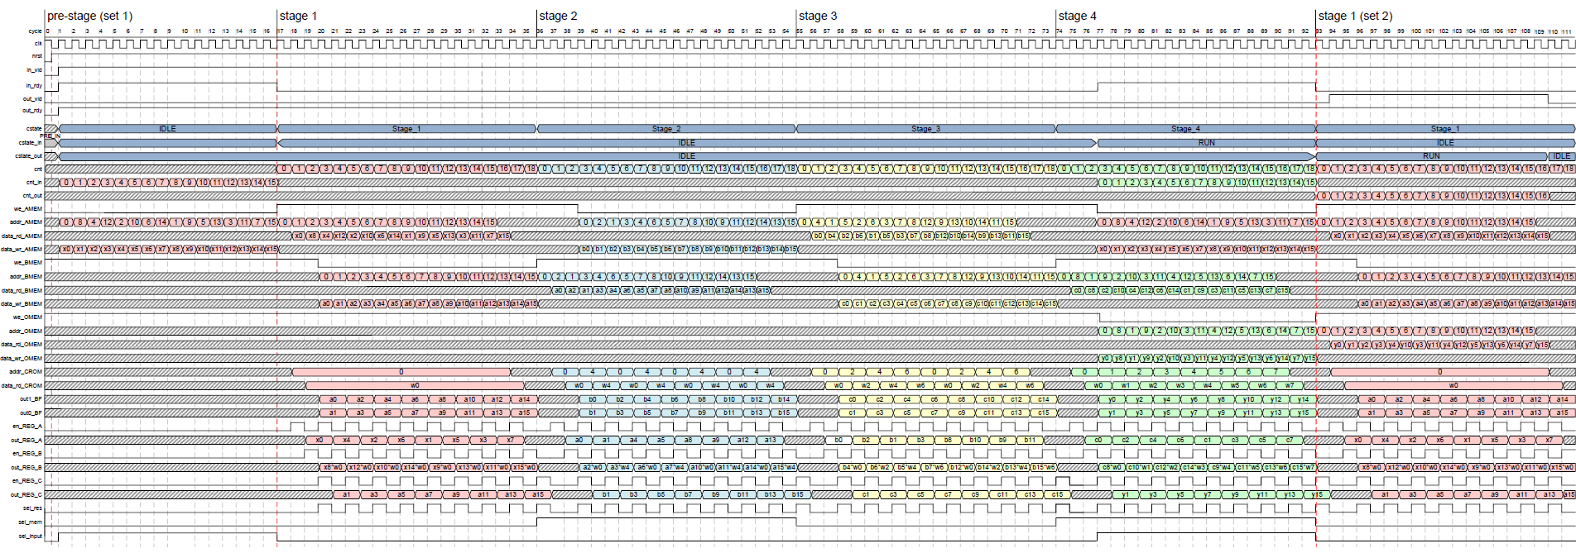
Timing Diagram

Slide 18
Radix-2 16pt DIT MBFFT
FSM
PRE_IN, IDLE, RUN, STAGE_N
Counter
cnt, cnt_in, cnt_out, cnt_dly, cnt_CROM
Enable CLs
we_AMEM, we_BMEM, we_OMEM
MUX select
sel_input, sel_res, sel_mem
Handshake
in_rdy, out_vld
Address
AMEM, BMEM, OMEM, CROM

Slide 19
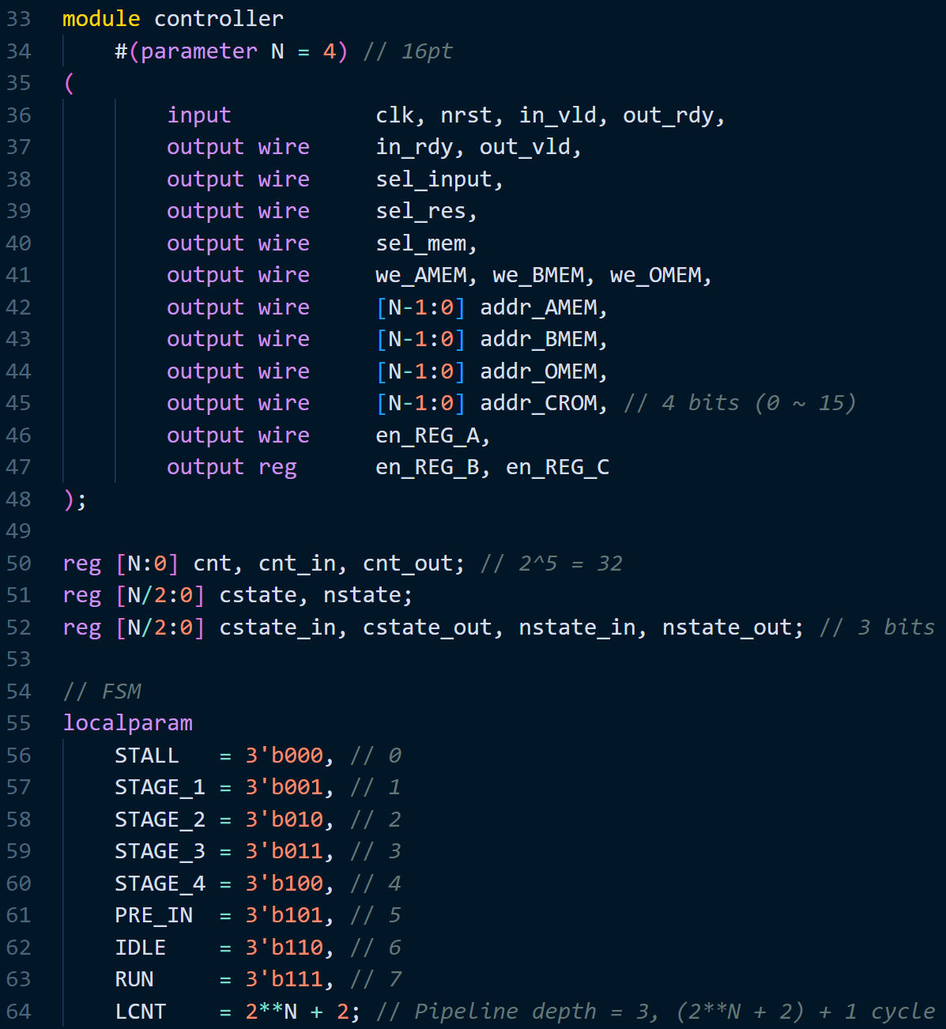
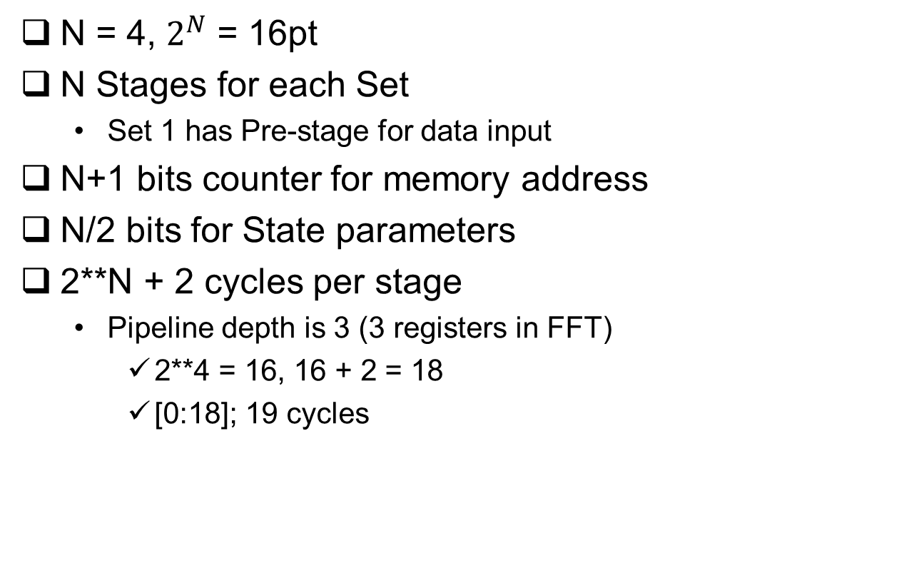
Radix-2 16pt DIT MBFFT
N = 4, $2^{N}$ = 16pt
N Stages for each Set
Set 1 has Pre-stage for data input
N+1 bits counter for memory address
N/2 bits for State parameters
2**N + 2 cycles per stage
Pipeline depth is 3 (3 registers in FFT)
2**4 = 16, 16 + 2 = 18
[0:18]; 19 cycles

Slide 20
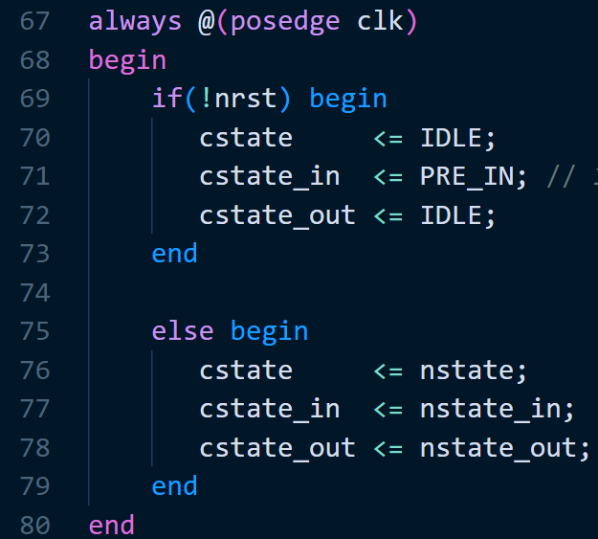
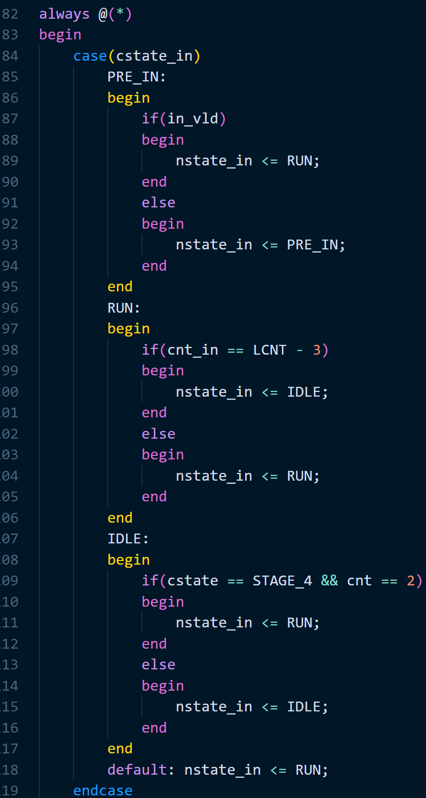
Radix-2 16pt DIT MBFFT
FSM
cstate are 1 cycle delay by nstate
cstate_in
PRE_IN >> RUN
in_vld == 1, after nrst
RUN >> IDLE
LCNT – 3, after finish external data input
LCNT = 2**N + 2 // 18 cycles
IDLE >> RUN
In STAGE_4, after 3 cycles
external data input for next set of FFT

Slide 21
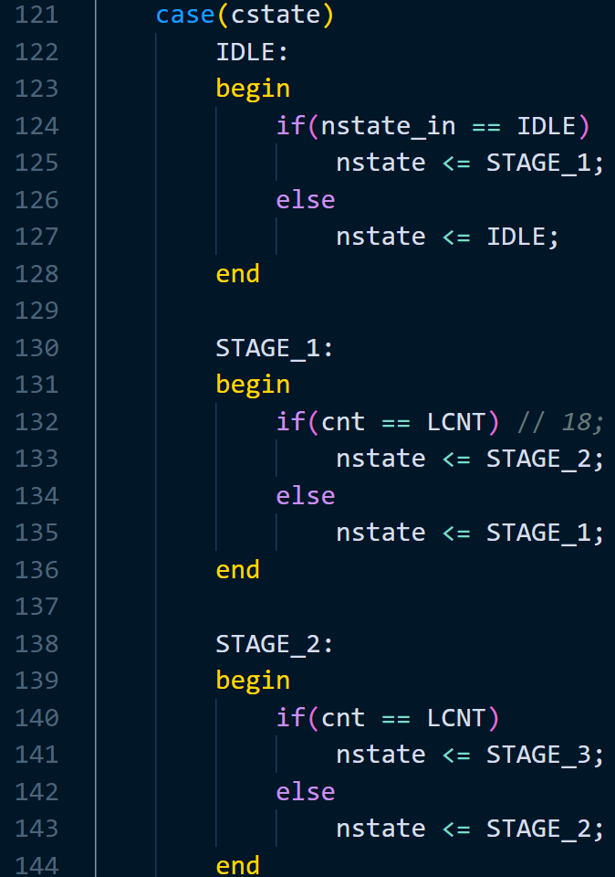
Radix-2 16pt DIT MBFFT
cstate
IDLE >> STAGE_1
nstate_in == IDLE, after finish ext_data_in
STAGE T >> STAGE T+1
After LCNT move to next stage
STAGE_4 >> STAGE_1

Slide 22
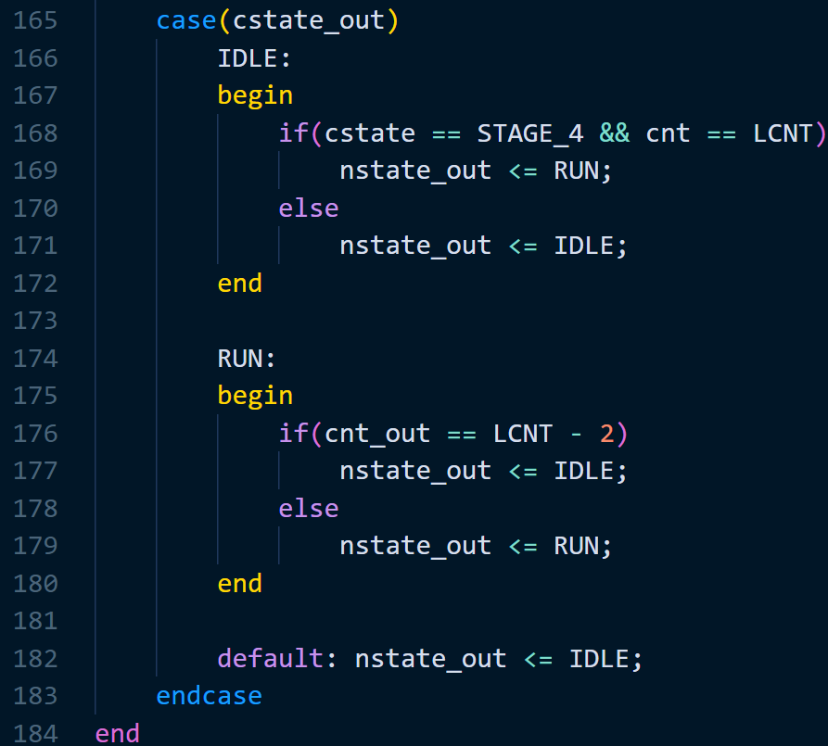
Radix-2 16pt DIT MBFFT
cstate_out
IDLE >> RUN
After current set finished
RUN >> IDLE
After outputting all FFT result

Slide 23
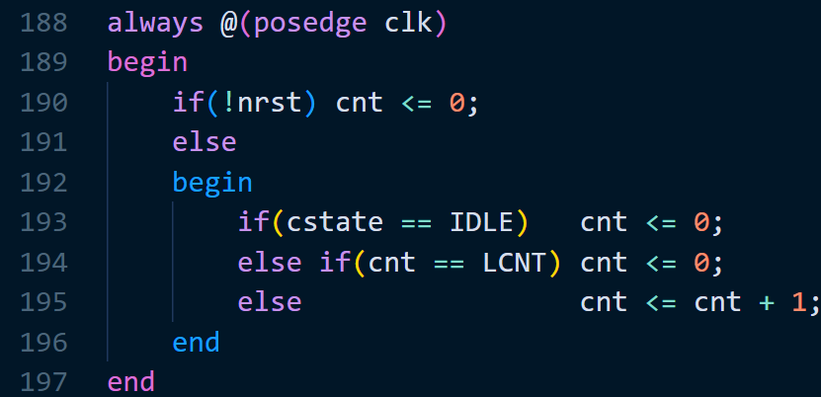
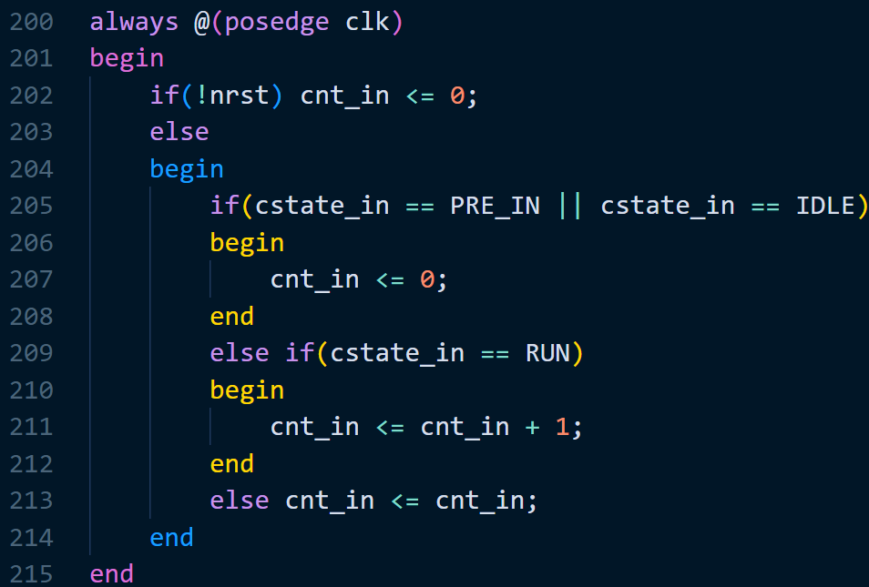
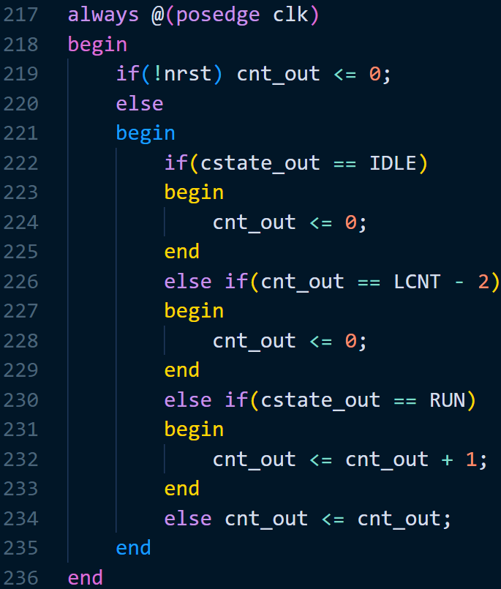
Radix-2 16pt DIT MBFFT
Counters
cnt
Count until LCNT
cnt_in
Count when ext_data_in is inputting
cnt_out
Count when outputting the FFT result

Slide 24
Radix-2 16pt DIT MBFFT
Control signals
Register Enable
en_REG_A is high; (0 index digit of binary counter) == 1
en_REG_B is 1 cycle delay to A, C is 1 cycle delay to B
Memory Write Enable
~we_AMEM; Pre-stage and Even # stages after 3 cycles
~we_BMEM; Odd # stages after 3 cycles
~we_OMEM; cstate_in == RUN and Stage 4
Pipeline depth for each stage is 3 cycles

Slide 25
Radix-2 16pt DIT MBFFT
Control signals
Input ready and Output valid signals
out_vld; cstate_out == RUN and cnt_out == TRUE
1 cycle delay because of data_rd_OMEM
MUX control signals
sel_input; 0 >> out_FFT, 1 >> ext_data_in
sel_res; 0 >> out_REG_C, 1 >> out1_BF
sel_mem; 0 >> AMEM, 1 >> BMEM

Slide 26
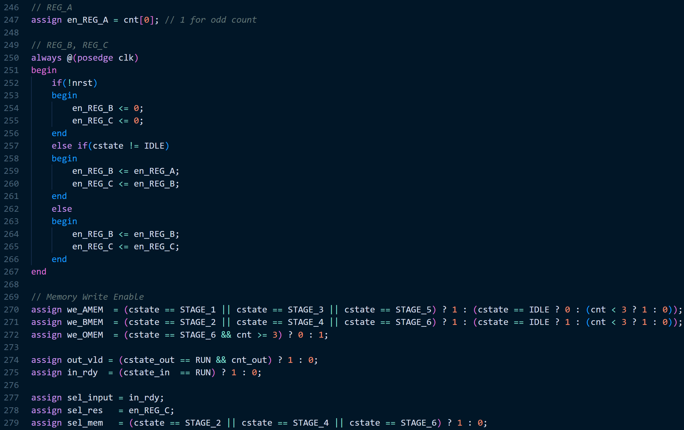
Radix-2 64pt DIT MBFFT
Control signals for, N = 6

Slide 27
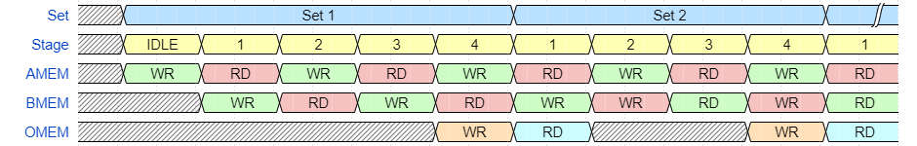
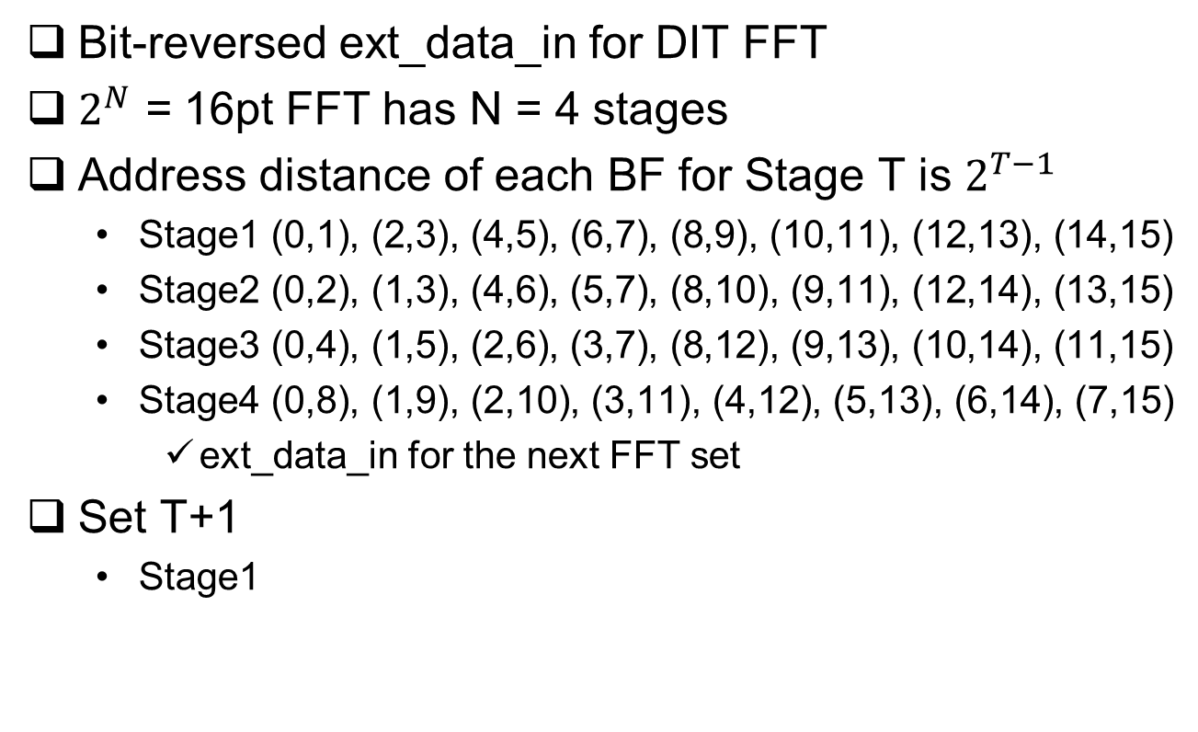
Radix-2 16pt DIT MBFFT
Bit-reversed ext_data_in for DIT FFT
$2^{N}$ = 16pt FFT has N = 4 stages
Address distance of each BF for Stage T is $2^{T−1}$
Stage1 (0,1), (2,3), (4,5), (6,7), (8,9), (10,11), (12,13), (14,15)
Stage2 (0,2), (1,3), (4,6), (5,7), (8,10), (9,11), (12,14), (13,15)
Stage3 (0,4), (1,5), (2,6), (3,7), (8,12), (9,13), (10,14), (11,15)
Stage4 (0,8), (1,9), (2,10), (3,11), (4,12), (5,13), (6,14), (7,15)
ext_data_in for the next FFT set
Set T+1
Stage1

Slide 28
Radix-2 16pt DIT MBFFT
RD address and WR address is same in each stage
In-place
If RD in AMEM (0,2), then WR in BMEM (0,2)
AMEM, BMEM Address
Pre-stage (ext_data_in → Write AMEM)
Stage1 (Read AMEM → Write BMEM)
Stage2 (Read BMEM → Read AMEM)
Stage3 (Read AMEM → Write BMEM)
Stage4 (Read BMEM → Write OMEM)
Same for 64pt, the only change is N = 6

Slide 29
Radix-2 16pt DIT MBFFT
OMEM Address
Same as BMEM address in Stage4; (k,k+8), k = 0 ~ 7
Same as cnt_out in the next set Stage1
Bit-reversal input >> Natural order output
ROM Address
Stage1; 0
Stage2; {0, cnt[0], 0, 0}//4*cnt[0]
Stage3; {0, cnt[1], cnt[0], 0}//4*cnt[1]+2*cnt[0]
Stage4; Same as cnt value

Slide 30
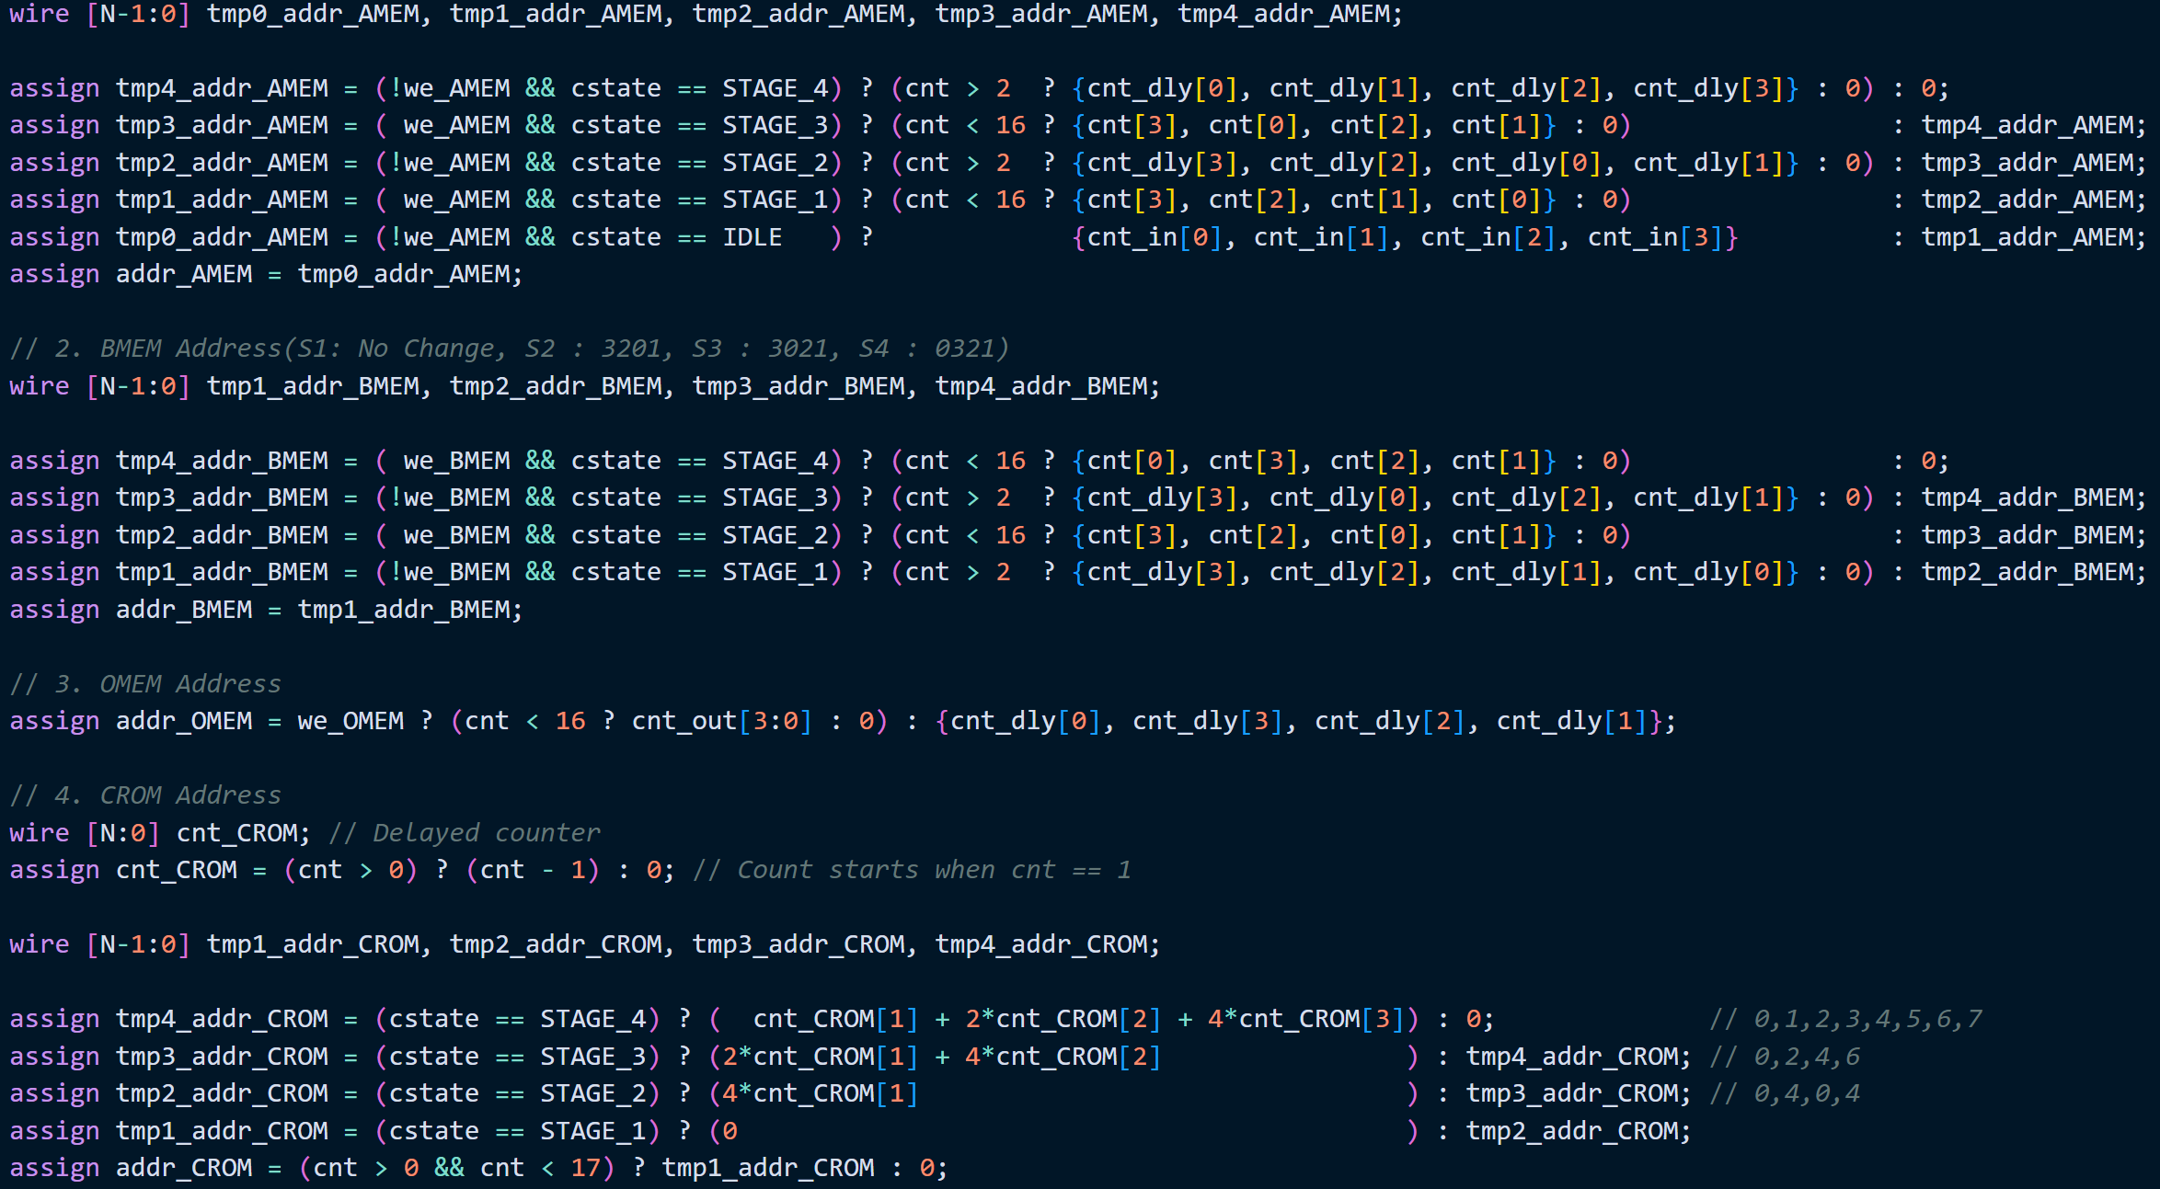
Radix-2 16pt DIT MBFFT
Addresses for 16pt FFT

Slide 31
Radix-2 64pt DIT MBFFT
FFT 64pt shares the same architecture with 16pt but,
Address bit-width has increased; N = 4 >> N = 6
Two more stages; 6 – 4 = 2
2**N + 2 cycles per stage; 66 cycles
All modules are reusable, but controller

Slide 32
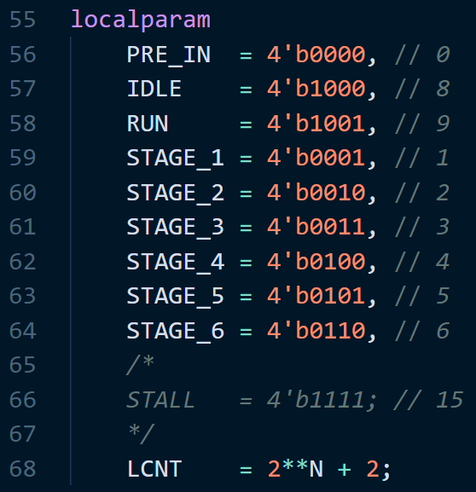
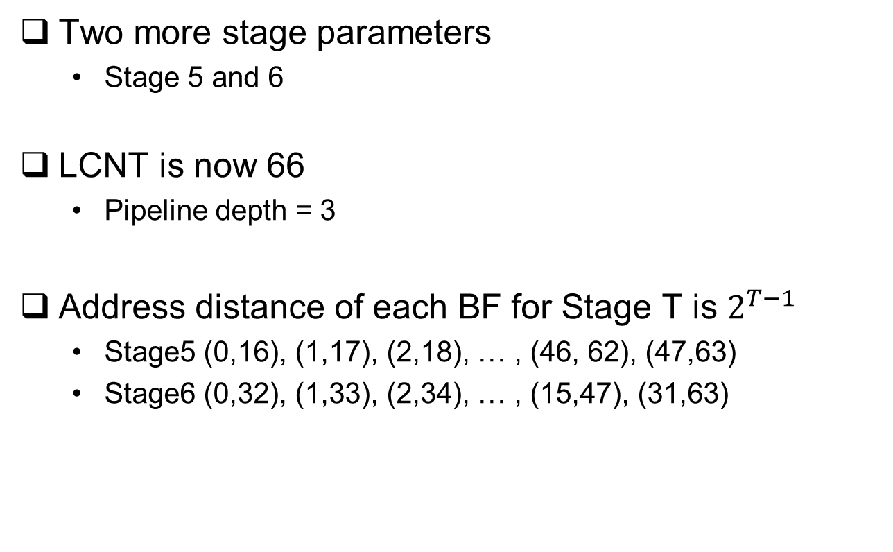
Radix-2 64pt DIT MBFFT
Two more stage parameters
Stage 5 and 6
LCNT is now 66
Pipeline depth = 3
Address distance of each BF for Stage T is $2^{T−1}$
Stage5 (0,16), (1,17), (2,18), … , (46, 62), (47,63)
Stage6 (0,32), (1,33), (2,34), … , (15,47), (31,63)

Slide 33
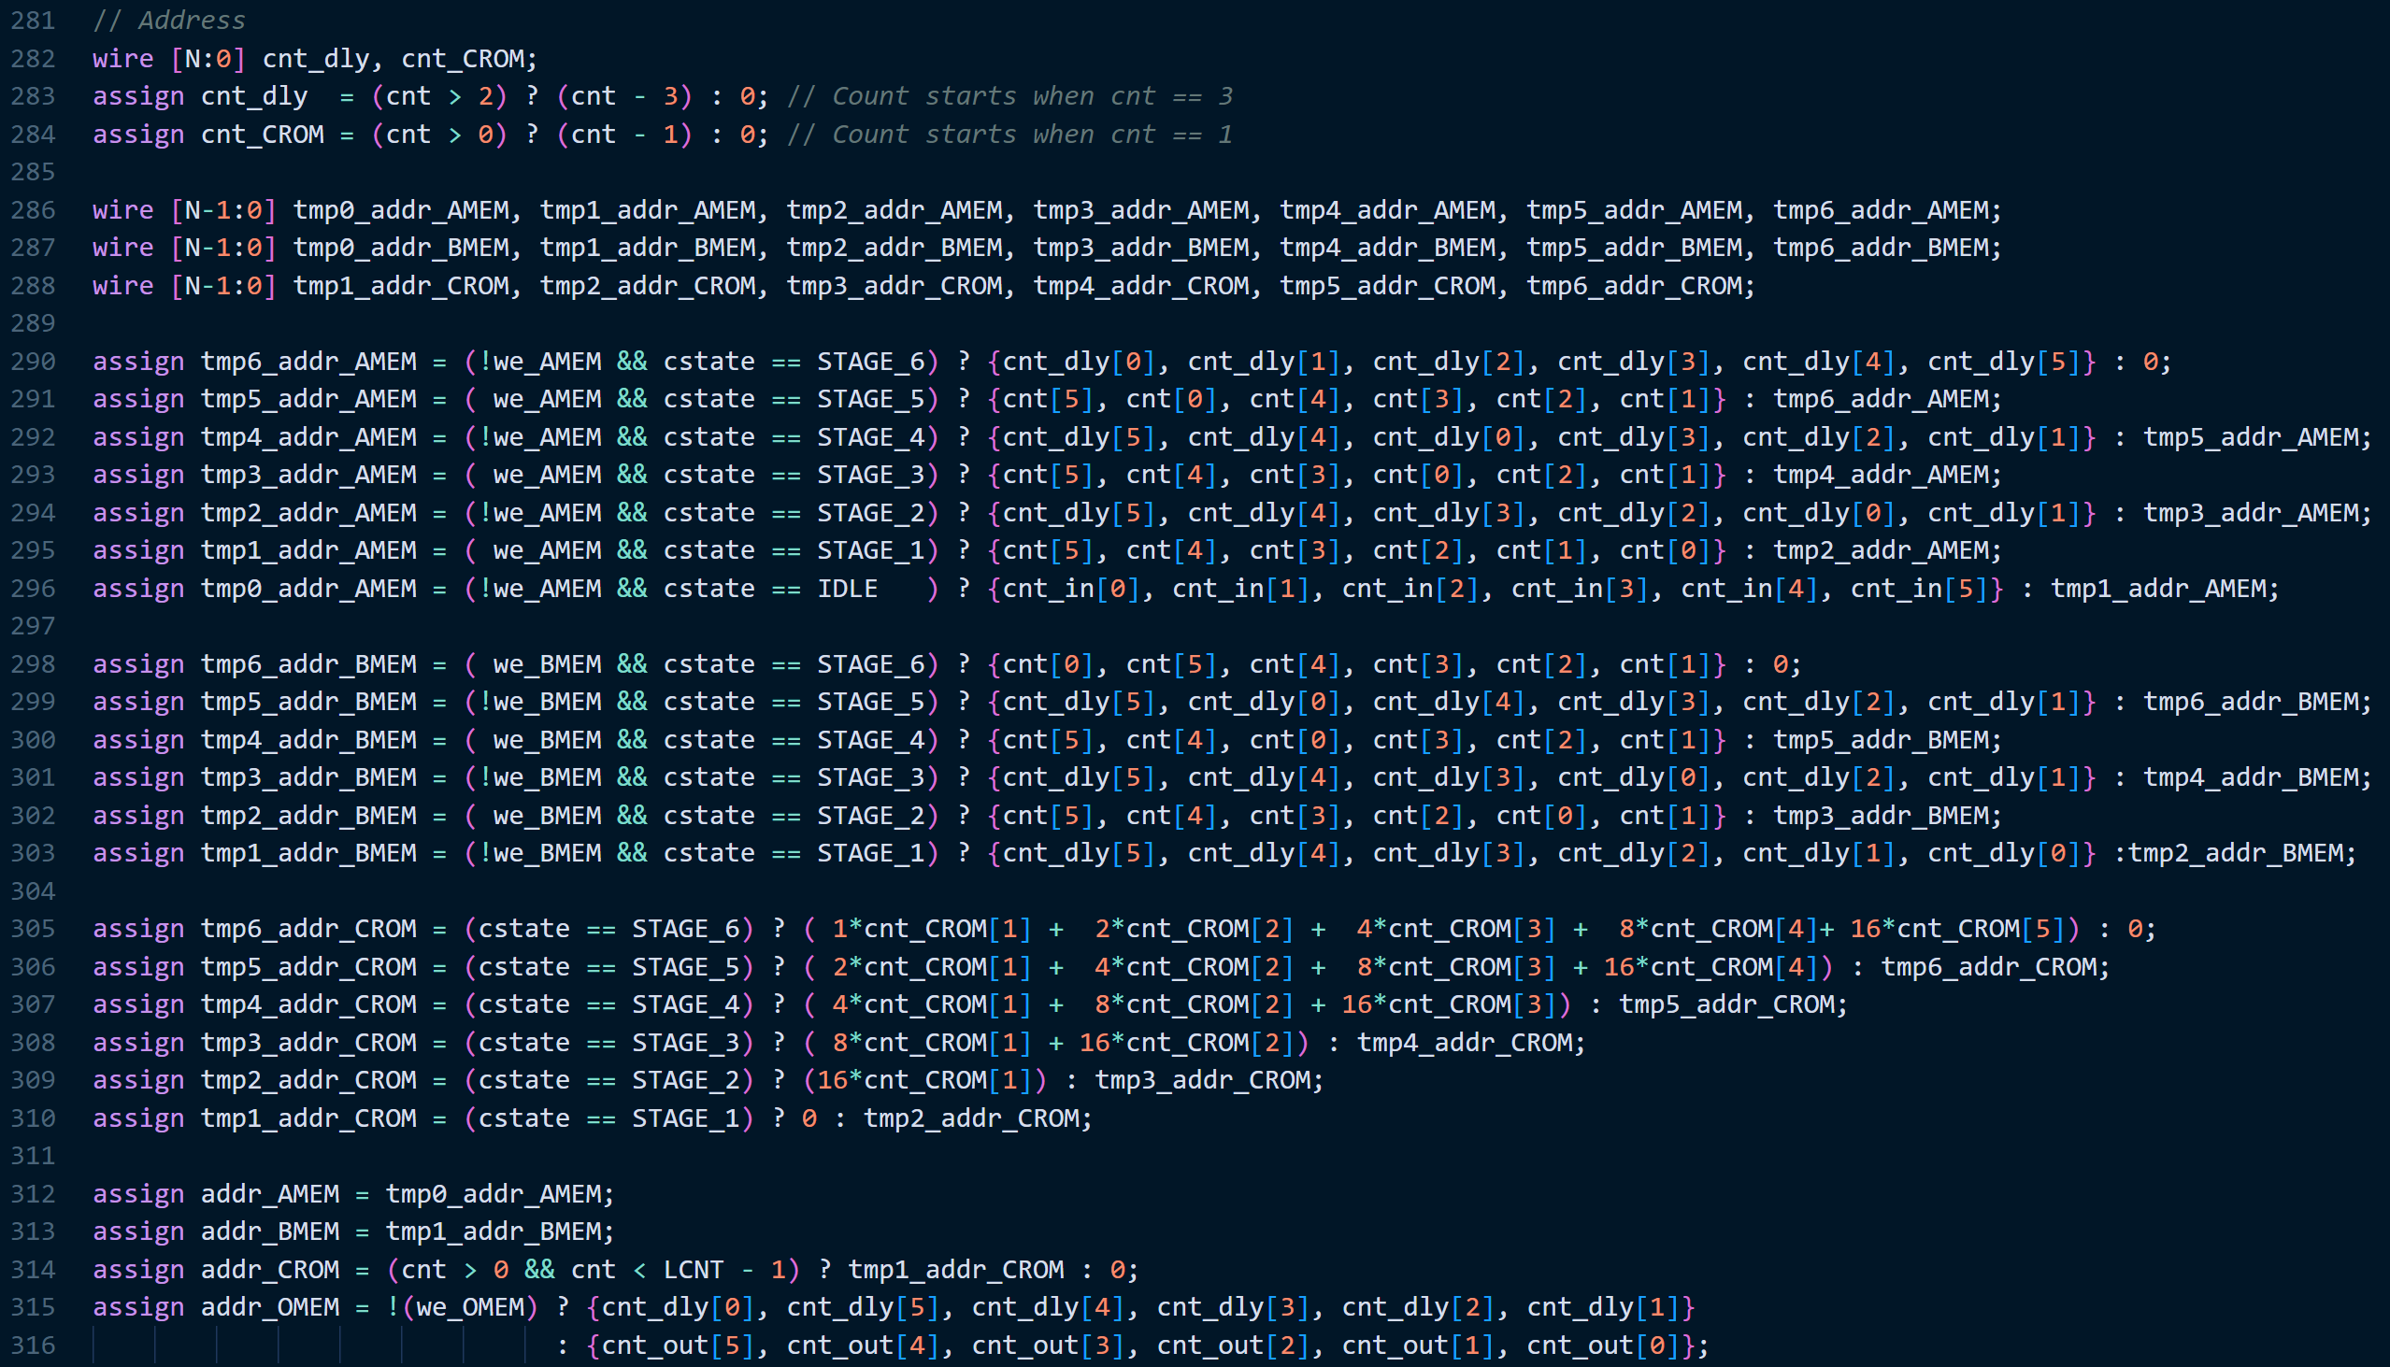
Radix-2 64pt DIT MBFFT
Addresses for 64pt FFT

Slide 34
Radix-2 16pt DIT MBFFT
AMEM(32x16)
cstate | IDLE | STAGE_1 | STAGE_2 | STAGE_3 | STAGE_4 | STAGE_1
addr | data_wr | data_rd | data_wr | data_rd | data_wr | data_rd
0000 | x[0] | x[0] | b[0] | b[0] | x2[0] | x2[0]
0001 | x[8] | x[8] | b[1] | b[1] | x2[8] | x2[8]
0010 | x[4] | x[4] | b[2] | b[2] | x2[4] | x2[4]
0011 | x[12] | x[12] | b[3] | b[3] | x2[12] | x2[12]
0100 | x[2] | x[2] | b[4] | b[4] | x2[2] | x2[2]
0101 | x[10] | x[10] | b[5] | b[5] | x2[10] | x2[10]
0110 | x[6] | x[6] | b[6] | b[6] | x2[6] | x2[6]
0111 | x[14] | x[14] | b[7] | b[7] | x2[14] | x2[14]
1000 | x[1] | x[1] | b[8] | b[8] | x2[1] | x2[1]
1001 | x[9] | x[9] | b[9] | b[9] | x2[9] | x2[9]
1010 | x[5] | x[5] | b[10] | b[10] | x2[5] | x2[5]
1011 | x[13] | x[13] | b[11] | b[11] | x2[13] | x2[13]
1100 | x[3] | x[3] | b[12] | b[12] | x2[3] | x2[3]
1101 | x[11] | x[11] | b[13] | b[13] | x2[11] | x2[11]
1110 | x[7] | x[7] | b[14] | b[14] | x2[7] | x2[7]
1111 | x[15] | x[15] | b[15] | b[15] | x2[15] | x2[15]

Slide 35
Radix-2 16pt DIT MBFFT
BMEM(32x16)
cstate | IDLE | STAGE_1 | STAGE_2 | STAGE_3 | STAGE_4 | STAGE_1
addr | data_wr | data_rd | data_wr | data_rd | data_wr | data_rd
0000 |  | a[0] | a[0] | c[0] | c[0] | a2[0]
0001 |  | a[1] | a[1] | c[1] | c[1] | a2[1]
0010 |  | a[2] | a[2] | c[2] | c[2] | a2[2]
0011 |  | a[3] | a[3] | c[3] | c[3] | a2[3]
0100 |  | a[4] | a[4] | c[4] | c[4] | a2[4]
0101 |  | a[5] | a[5] | c[5] | c[5] | a2[5]
0110 |  | a[6] | a[6] | c[6] | c[6] | a2[6]
0111 |  | a[7] | a[7] | c[7] | c[7] | a2[7]
1000 |  | a[8] | a[8] | c[8] | c[8] | a2[8]
1001 |  | a[9] | a[9] | c[9] | c[9] | a2[9]
1010 |  | a[10] | a[10] | c[10] | c[10] | a2[10]
1011 |  | a[11] | a[11] | c[11] | c[11] | a2[11]
1100 |  | a[12] | a[12] | c[12] | c[12] | a2[12]
1101 |  | a[13] | a[13] | c[13] | c[13] | a2[13]
1110 |  | a[14] | a[14] | c[14] | c[14] | a2[14]
1111 |  | a[15] | a[15] | c[15] | c[15] | a2[15]

Slide 36
Radix-2 16pt DIT MBFFT
OMEM(32X16)
cstate | STAGE_4 | STAGE_1
addr | data_wr | data_rd
0000 | y[0] | y[0]
0001 | y[1] | y[1]
0010 | y[2] | y[2]
0011 | y[3] | y[3]
0100 | y[4] | y[4]
0101 | y[5] | y[5]
0110 | y[6] | y[6]
0111 | y[7] | y[7]
1000 | y[8] | y[8]
1001 | y[9] | y[9]
1010 | y[10] | y[10]
1011 | y[11] | y[11]
1100 | y[12] | y[12]
1101 | y[13] | y[13]
1110 | y[14] | y[14]
1111 | y[15] | y[15]
CROM(32x8)
addr | data
0000 | 00007FFE
0001 | CF047642
0010 | A57E5A82
0011 | 89BE30FC
0100 | 80020000
0101 | 89BECF04
0110 | A57EA57E
0111 | CF0489BE

Slide 37
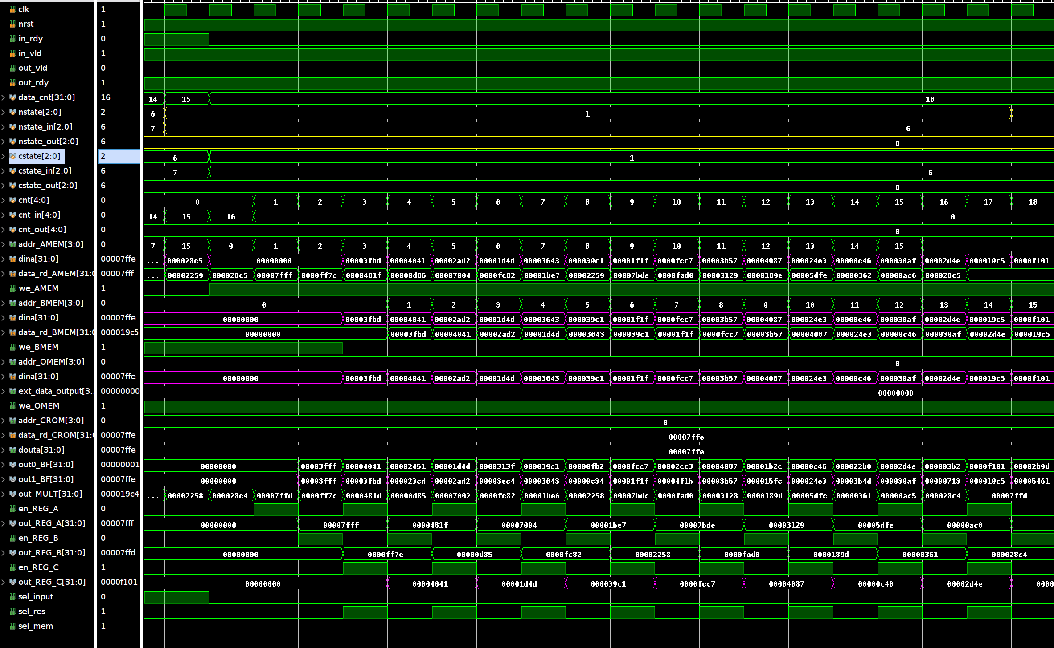
STAGE_1

Slide 38
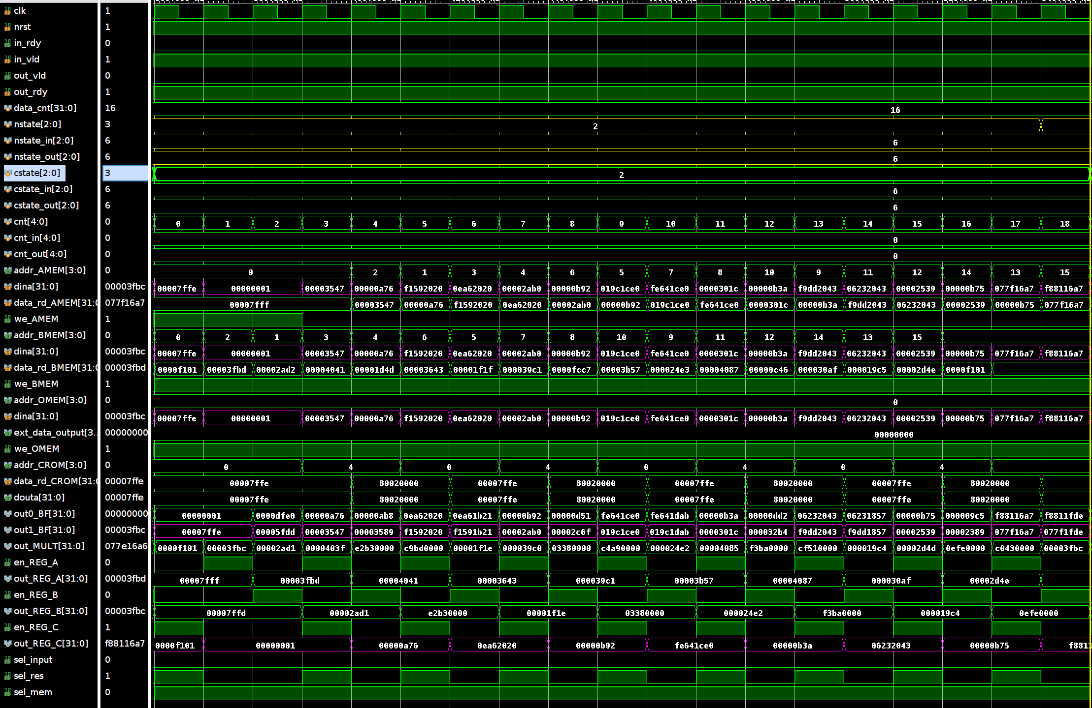
STAGE_2

Slide 39
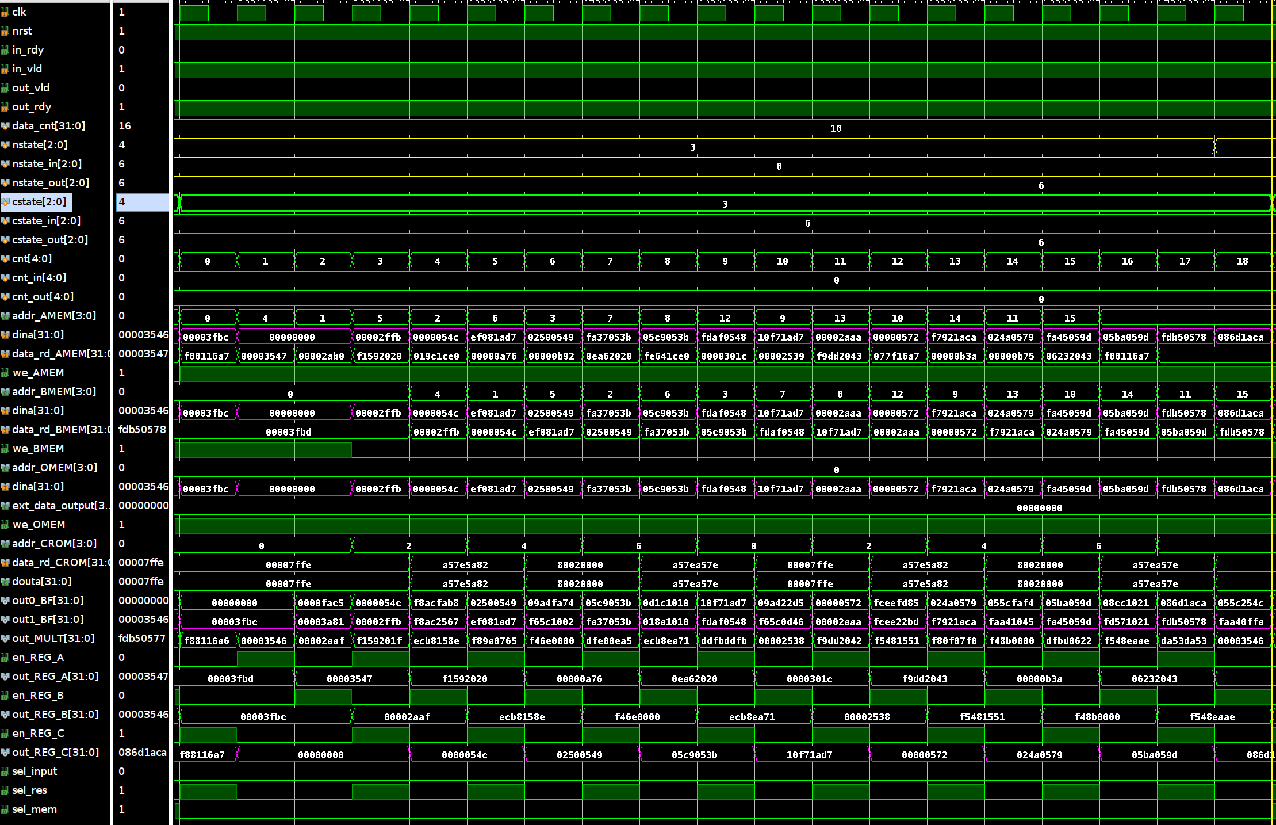
STAGE_3

Slide 40
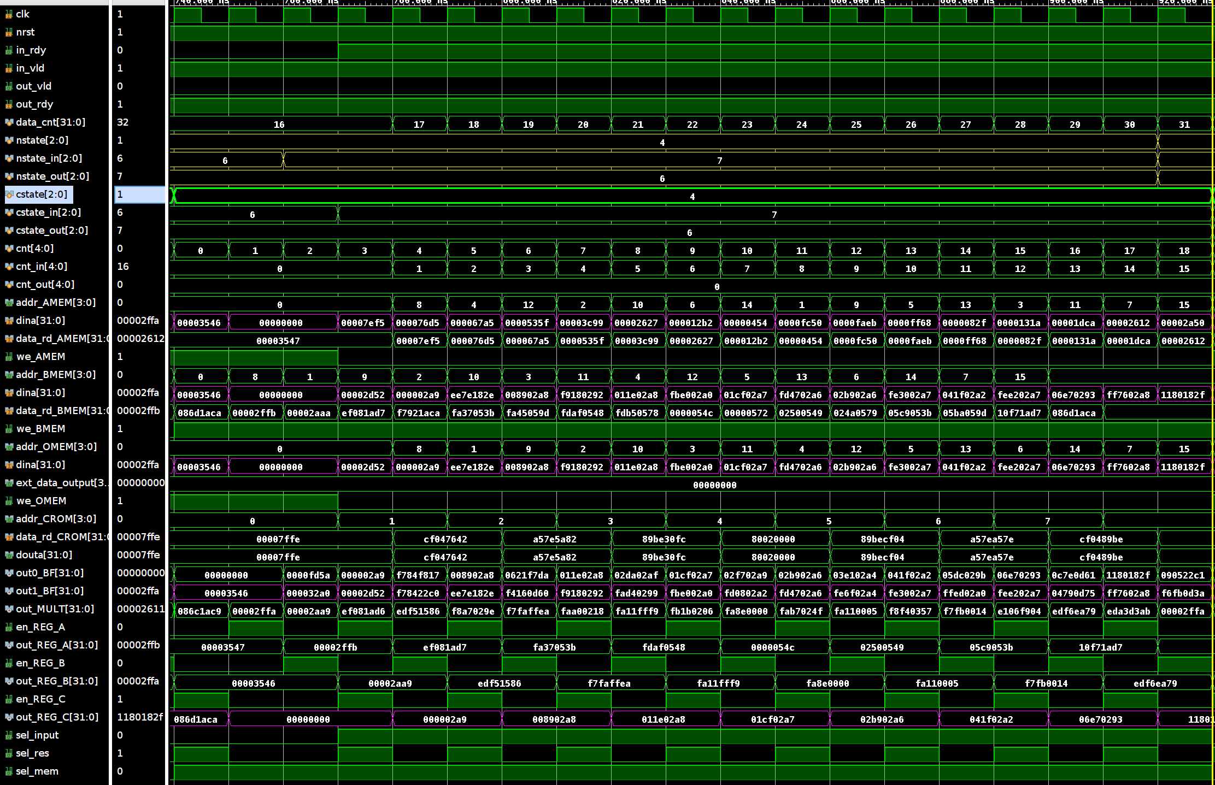
STAGE_4

Slide 41
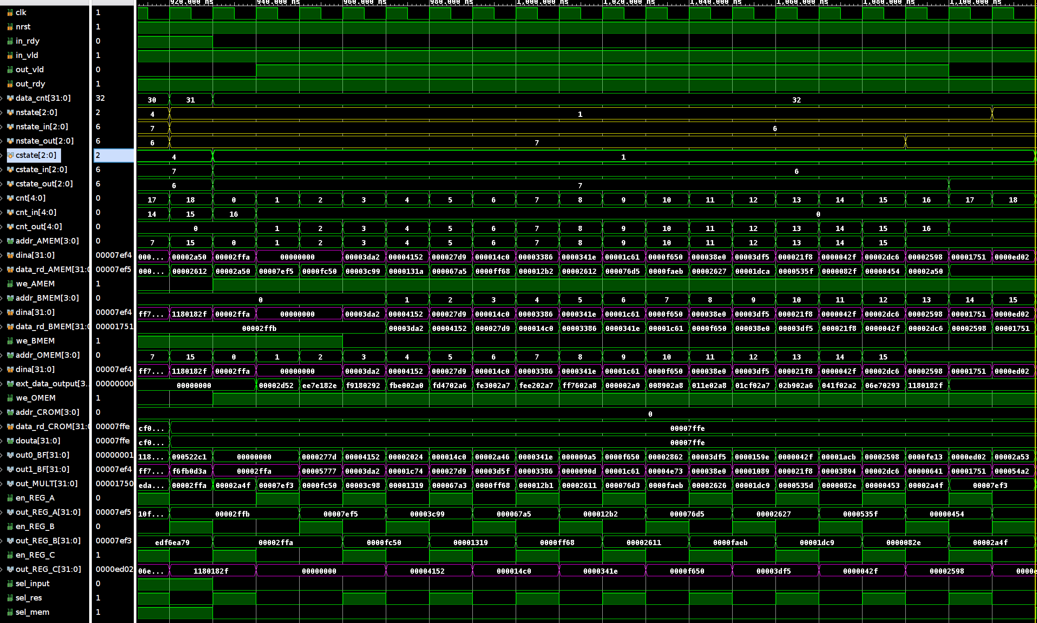
SET 2

Slide 42
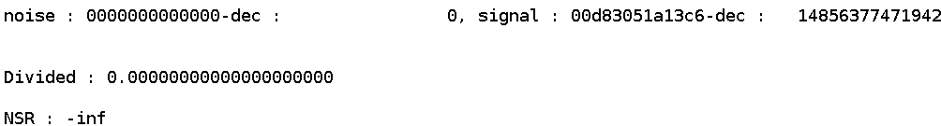
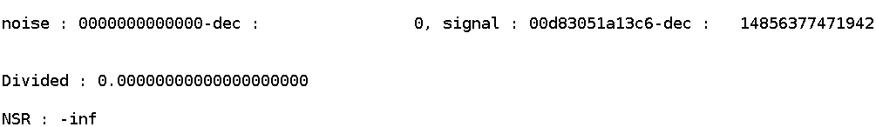
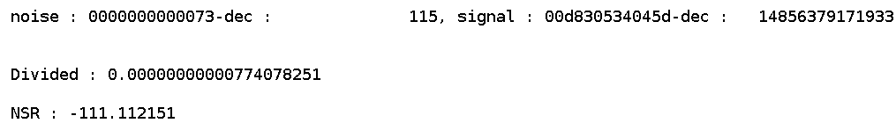
Simulation Results
SPBRAM 16pt
Behavioral simulation
Post-Synthesis Timing simulation
Post-Implementation Timing simulation

Slide 43
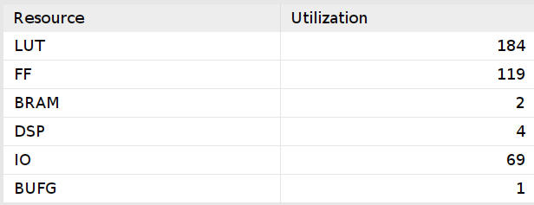
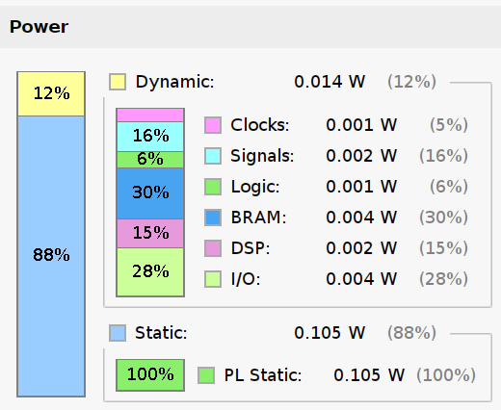
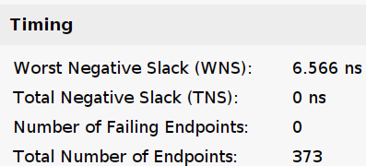
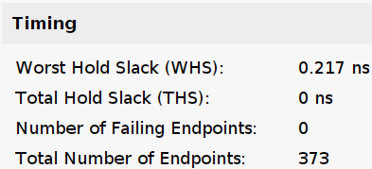
Simulation Results
SPBRAM 16pt

Slide 44
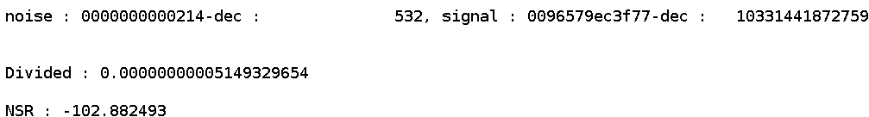
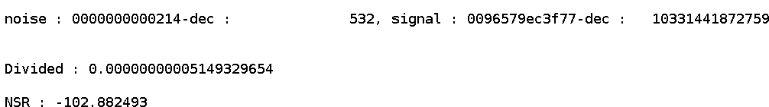

Simulation Results
SPBRAM 64pt
Behavioral simulation
Post-Synthesis Timing simulation
Post-Implementation Timing simulation

Slide 45




Simulation Results
SPBRAM 64pt

Slide 46
Reusable Design
Operation Cycles
External data write into AMEM
Cycle 0: Read assert to AMEM in bit-reversed order
Cycle 1: Mem data >> REG_A
Cycle 2: MEM data >> MULT >> REG_B
Cycle 3: REG_A, REG_B >> REG_C, out_BF1
Cycle 4: REG_C >> BMEM
Cycle 5: out_BF1 >> BMEM

Slide 47


Reusable Design
Stage, Butterfly Unit, Index (n,b,k)
n = [0, log2(N) - 1]
b = [0, N/2**n - 1]
k = [0, 2**n - 1]
N = 16 points
x[0] >> (0,0,0)
x[6] >> (0,3,0)
a[2] >> (0,0,1)
b[7] >> (2,0,7)

Slide 48
Reusable Design
addr
(1 << cnt_n)*cnt_b + cnt_k + cnt_i*(1 << (cnt_n - 1))
addr_CROM
(1 << (N-cnt_n))*cnt_k

Slide 49
Reusable Design
Bit-reversed input
cnt (0~15)

Slide 50
Reusable Design
Stage 1
n = 0
b = 0 ~ 7
k = 0

Slide 51
Reusable Design
Stage 2
n = 1
b = 0 ~ 3
k = 0 ~ 1

Slide 52
Reusable Design
Stage 3
n = 2
b = 0 ~ 1
k = 0 ~ 3

Slide 53
Reusable Design
Stage 4
n = 3
b = 0
k = 0 ~ 7

Slide 54
Reusable Design
controller.v
module controller #(
PNT = 16,
N = $clog2(PNT) // STAGE
)(
input clk,
input rstn,
input in_vld,
input out_rdy,
output wire in_rdy,
output wire out_vld,
output wire sel_input,
output wire sel_res,
output wire sel_mem,
output wire we_AMEM,
output wire we_BMEM,
output wire we_OMEM,
output wire [N-1:0] addr_AMEM,
output wire [N-1:0] addr_BMEM,
output wire [N-1:0] addr_OMEM,
output wire [9:0] addr_CROM,
output wire en_REG_A,
output reg en_REG_B,
output reg en_REG_C
);
wire [$clog2(N):0] last_n;
wire [$clog2(PNT/2):0] last_b;
wire [$clog2(PNT/2):0] last_k;
assign last_n = N;
assign last_b = PNT/(1 << cnt_n) - 1;
assign last_k = (1 << (cnt_n-1)) - 1;
assign last_i = 1;
// Counter
reg [N:0] cnt;
always @(posedge clk or negedge rstn) begin
if (!rstn) begin
cnt <= 0;
end else begin
if (state == IDLE) begin
cnt <= (cnt == PNT-1) ? 0 : cnt+1;
end else if (state == RUN || state == BUBL) begin
cnt <= (cnt == PNT-1 + 3) ? 0 : cnt+1; // Pipeline depth: 3
end else cnt <= cnt;
end
end

Slide 55
Reusable Design
controller.v
reg [$clog2(8192):0] cnt_s;
reg [$clog2(8192):0] tmp_cnt_s;
reg [$clog2(N):0] cnt_n;
reg [$clog2(N):0] tmp_cnt_n;
reg [$clog2(PNT/2):0] cnt_b;
reg [$clog2(PNT/2):0] cnt_k;
reg cnt_i;
always @(posedge clk or negedge rstn) begin
if (!rstn) begin
cnt_s <= 0; // SET
tmp_cnt_s <= 0;
end
else begin
if (cnt_n == last_n && cnt_b == last_b && cnt_k == last_k && cnt_i == last_i)
tmp_cnt_s = cnt_s + 1;
else if (cnt == PNT+2 && state == BUBL)
cnt_s <= tmp_cnt_s;
end
end

Slide 56
Reusable Design
always @(posedge clk or negedge rstn) begin
if (!rstn) begin
cnt_n <= 0; // STAGE
tmp_cnt_n <= 0;
cnt_b <= 0; // BU
cnt_k <= 0; // INDEX
cnt_i <= 0; // 0,1
end else if (state == RUN) begin
if (cnt_b == last_b && cnt_k == last_k && cnt_i == last_i) begin
tmp_cnt_n <= (cnt_n == last_n) ? 1 : cnt_n+1;
cnt_b <= 0;
cnt_k <= 0;
cnt_i <= 0;
end else if (cnt_k == last_k && cnt_i == last_i) begin
cnt_b <= (cnt_b == last_b) ? 0 : cnt_b+1;
cnt_k <= 0;
cnt_i <= 0;
end else if (cnt_i == last_i) begin
cnt_k <= (cnt_k == last_k) ? 0 : cnt_k+1;
cnt_i <= 0;
end else cnt_i <= (cnt_i == last_i) ? 0 : cnt_i+1;
end else if (state == IDLE) begin
if (cnt == PNT-1) cnt_n <= cnt_n + 1;
end else if (cnt == PNT+2 && state == BUBL) begin
cnt_n <= tmp_cnt_n;
cnt_b <= 0;
cnt_k <= 0;
cnt_i <= 0;
end else begin
cnt_n <= cnt_n;
cnt_b <= cnt_b;
cnt_k <= cnt_k;
cnt_i <= cnt_i;
end
end
controller.v

Slide 57
Reusable Design
controller.v
// FSM
localparam BUBL = 2'b00;
localparam IDLE = 2'b10;
localparam RUN = 2'b11;
reg [1:0] state;
reg [1:0] next;
always @(posedge clk or negedge rstn) begin
if (!rstn) begin
state <= IDLE;
end else begin
state <= next;
end
end
always @(*) begin
case(state)
IDLE: begin
if (cnt == PNT-1) next <= RUN;
else next <= IDLE;
end
RUN : begin
if (cnt_b == last_b && cnt_k == last_k && cnt_i == last_i)
next <= BUBL;
else next <= RUN;
end
BUBL: begin
if (cnt_n == 0 && cnt == PNT+2) next <= RUN;
if (cnt == PNT+2) next <= RUN;
else next <= BUBL;
end
default: next <= IDLE;
endcase
end

Slide 58
Reusable Design
controller.v
assign en_REG_A = (state == RUN) ? cnt[0] : 0;
always @(posedge clk or negedge rstn) begin
if (!rstn) begin
en_REG_B <= 0;
en_REG_C <= 0;
end else if (state == RUN || state == BUBL) begin
en_REG_B <= en_REG_A;
en_REG_C <= en_REG_B;
end else begin
en_REG_B <= en_REG_B;
en_REG_C <= en_REG_C;
end
end
reg [1:0] mode_reg;
wire [1:0] mode;
always @(posedge clk or negedge rstn) begin
if (!rstn) mode_reg <= 0;
else if (state == RUN) mode_reg <= mode;
else mode_reg <= mode_reg;
end
assign mode = (state == IDLE) ? 2'b11
: (state == RUN && cnt_n % 2 == 1) ? 2'b10 // RD(A), WR(B)
: (state == RUN && cnt_n % 2 == 0) ? 2'b01 // RD(B), WR(A)
: (state == BUBL) ? mode_reg : 0;
assign we_AMEM = (mode == 2'b11 || (cnt>2 && mode == 2'b01)) ? 1'b1 : 1'b0;
assign we_BMEM = ((cnt>2) && mode == 2'b10) ? 1'b1 : 1'b0;
assign we_OMEM = (cnt>2 && mode == 2'b01) ? 1'b1 : 1'b0;
assign sel_input = in_rdy;
assign sel_mem = (mode == 2'b10) ? 1'b0 // RD AMEM
: (mode == 2'b01) ? 1'b1 // RD BMEM
: 'b0;
assign sel_res = en_REG_C;

Slide 59
Reusable Design
controller.v
wire [N:0] cntd;
assign cntd = (cnt>0) ? cnt-1 : 'b0; // 1 cycle delayed counter
assign in_rdy = (cnt_n == 0 || (cnt>2 && cnt_n == last_n)) ? 1'b1 : 1'b0;
assign out_vld = (!cnt_s) ? 1'b0 : (cnt>0 && cnt_n == 1 && cntd<PNT) ? 1'b1 : 1'b0; // set 2 부터
// DIT input
function [N-1:0] bit_reverse;
input [N-1:0] in;
integer i;
begin
for (i=0; i<N; i=i+1) begin
bit_reverse[i] = in[N-1-i];
end
end
endfunction
reg [N-1:0] tmp1_addr_d, tmp2_addr_d, addr_d; // delayed by pipeline depth: 3
wire [N-1:0] addr;
wire [N-1:0] cnt_scaled = cnt[N-1:0];
assign addr = (state == IDLE) ? bit_reverse(cnt_scaled)
: (1 << cnt_n)*cnt_b + cnt_k + cnt_i*(1 << (cnt_n-1));
always @(posedge clk or negedge rstn) begin
if (!rstn) begin
tmp1_addr_d <= 0;
tmp2_addr_d <= 0;
addr_d <= 0;
end else begin
tmp1_addr_d <= addr;
tmp2_addr_d <= tmp1_addr_d;
addr_d <= tmp2_addr_d;
end
end

Slide 60
Reusable Design
controller.v
wire [N-1:0] cnt_scaled_d;
assign cnt_scaled_d = (cnt>2) ? cnt-3 : 'b0;
assign addr_AMEM = (cnt_n == last_n) ? bit_reverse(cnt_scaled_d) // Next set input
: (mode == 2'b10 || mode == 2'b11) ? addr // First set input or RD(A), WR(B)
: (mode == 2'b01) ? addr_d // RD(B), WR(A)
: 'b0;
assign addr_BMEM = (mode == 2'b01) ? addr
: (mode == 2'b10) ? addr_d
: 'b0;
assign addr_OMEM = (cnt_n == last_n) ? addr_d
:((mode == 2'b10 && cnt_n == 1) && cnt<PNT) ? cnt
: 'b0;
reg [9:0] tmp1_addr_CROM;
wire [9:0] tmp0_addr_CROM;
assign tmp0_addr_CROM = (1 << (N-cnt_n))*cnt_k;
always @(posedge clk or negedge rstn) begin
if (!rstn) begin
tmp1_addr_CROM <= 0;
//tmp2_addr_CROM <= 0;
end else begin
tmp1_addr_CROM <= tmp0_addr_CROM;
//tmp2_addr_CROM <= tmp1_addr_CROM;
end
end
assign addr_CROM = tmp1_addr_CROM;
endmodule

Slide 61


Reusable Design

Slide 62
Simple DPBRAM

Slide 63
Simple DPBRAM
Vertex Coloring
DIF
DIT
Block Diagram
Timing Diagram
Verilog Implementation
Simulation Results

Slide 64

Vertex Coloring
DIT FFT
Bit-reversed Input
bank0
[1] Hsin-Fu Lo, Ming-Der Shieh and Chien-Ming Wu, "Design of an efficient FFT processor for DAB system," ISCAS 2001. The 2001 IEEE International Symposium on Circuits and Systems (Cat. No.01CH37196), Sydney, NSW, Australia, 2001, pp. 654-657 vol. 4, doi: 10.1109/ISCAS.2001.922322.

Slide 65
Vertex Coloring
Address for DIF 16pt
Natural order inputs >> Bit-reversed outputs
Stage 1: (0,4), (4,0), (5,1), (1,5), (6,2), (2,6), (3,7), (7,3)
Stage 2: (0,2), (2,0), (3,1), (1,3), (6,4), (4,6), (5,7), (7,7)
Stage 3: (0,1), (1,0), (3,2), (2,3), (5,4), (4,5), (6,7), (7,6)
Stage 4: (0,0), (1,1), (2,2), (3,3), (4,4), (5,5), (6,6), (7,7)
Address for DIT 16pt
Bit-reversed inputs >> Natural order outputs
Stage 1: (0,0), (1,1), (2,2), (3,3), (4,4), (5,5), (6,6), (7,7)
Stage 2: (0,1), (1,0), (3,2), (2,3), (5,4), (4,5), (6,7), (7,6)
Stage 3: (0,2), (2,0), (3,1), (1,3), (6,4), (4,6), (5,7), (7,7)
Stage 4: (0,4), (4,0), (5,1), (1,5), (6,2), (2,6), (3,7), (7,3)

Slide 66
Simple DPBRAM
Vertex Coloring
DIF
DIT
Block Diagram
Timing Diagram
Verilog Implementation
Simulation Results

Slide 67

Vertex Coloring
addr | BANK0 | BANK1
000 | x[0] | x[1]
001 | x[3] | x[2]
010 | x[5] | x[4]
011 | x[6] | x[7]
100 | x[9] | x[8]
101 | x[10] | x[11]
110 | x[12] | x[13]
111 | x[15] | x[14]
addr | BANK0 | BANK1
000 | a[0] | x[1]
001 | x[3] | x[2]
010 | x[5] | x[4]
011 | x[6] | x[7]
100 | x[9] | a[8]
101 | x[10] | x[11]
110 | x[12] | x[13]
111 | x[15] | x[14]
addr | BANK0 | BANK1
000 | a[0] | a[1]
001 | x[3] | x[2]
010 | x[5] | x[4]
011 | x[6] | x[7]
100 | a[9] | a[8]
101 | x[10] | x[11]
110 | x[12] | x[13]
111 | x[15] | x[14]
addr | BANK0 | BANK1
000 | a[0] | a[1]
001 | x[3] | a[2]
010 | x[5] | x[4]
011 | x[6] | x[7]
100 | a[9] | a[8]
101 | a[10] | x[11]
110 | x[12] | x[13]
111 | x[15] | x[14]

Slide 68
Vertex Coloring
addr | BANK0 | BANK1
000 | a[0] | a[1]
001 | a[3] | a[2]
010 | x[5] | x[4]
011 | x[6] | x[7]
100 | a[9] | a[8]
101 | a[10] | a[11]
110 | x[12] | x[13]
111 | x[15] | x[14]
addr | BANK0 | BANK1
000 | a[0] | a[1]
001 | a[3] | a[2]
010 | x[5] | a[4]
011 | x[6] | x[7]
100 | a[9] | a[8]
101 | a[10] | a[11]
110 | a[12] | x[13]
111 | x[15] | x[14]
addr | BANK0 | BANK1
000 | a[0] | a[1]
001 | a[3] | a[2]
010 | a[5] | a[4]
011 | x[6] | x[7]
100 | a[9] | a[8]
101 | a[10] | a[11]
110 | a[12] | a[13]
111 | x[15] | x[14]
addr | BANK0 | BANK1
000 | a[0] | a[1]
001 | a[3] | a[2]
010 | a[5] | a[4]
011 | a[6] | x[7]
100 | a[9] | a[8]
101 | a[10] | a[11]
110 | a[12] | a[13]
111 | x[15] | a[14]

Slide 69
Vertex Coloring
addr | BANK0 | BANK1
000 | a[0] | a[1]
001 | a[3] | a[2]
010 | a[5] | a[4]
011 | a[6] | a[7]
100 | a[9] | a[8]
101 | a[10] | a[11]
110 | a[12] | a[13]
111 | a[15] | a[14]
addr | BANK0 | BANK1
000 | b[0] | a[1]
001 | a[3] | a[2]
010 | a[5] | b[4]
011 | a[6] | a[7]
100 | a[9] | a[8]
101 | a[10] | a[11]
110 | a[12] | a[13]
111 | a[15] | a[14]
addr | BANK0 | BANK1
000 | b[0] | b[1]
001 | a[3] | a[2]
010 | b[5] | b[4]
011 | a[6] | a[7]
100 | a[9] | a[8]
101 | a[10] | a[11]
110 | a[12] | a[13]
111 | a[15] | a[14]
addr | BANK0 | BANK1
000 | b[0] | b[1]
001 | a[3] | b[2]
010 | b[5] | b[4]
011 | b[6] | a[7]
100 | a[9] | a[8]
101 | a[10] | a[11]
110 | a[12] | a[13]
111 | a[15] | a[14]

Slide 70
Vertex Coloring
addr | BANK0 | BANK1
000 | b[0] | b[1]
001 | b[3] | b[2]
010 | b[5] | b[4]
011 | b[6] | b[7]
100 | a[9] | a[8]
101 | a[10] | a[11]
110 | a[12] | a[13]
111 | a[15] | a[14]
addr | BANK0 | BANK1
000 | b[0] | b[1]
001 | b[3] | b[2]
010 | b[5] | b[4]
011 | b[6] | b[7]
100 | a[9] | b[8]
101 | a[10] | a[11]
110 | b[12] | a[13]
111 | a[15] | a[14]
addr | BANK0 | BANK1
000 | b[0] | b[1]
001 | b[3] | b[2]
010 | b[5] | b[4]
011 | b[6] | b[7]
100 | b[9] | b[8]
101 | a[10] | a[11]
110 | b[12] | b[13]
111 | a[15] | a[14]
addr | BANK0 | BANK1
000 | b[0] | b[1]
001 | b[3] | b[2]
010 | b[5] | b[4]
011 | b[6] | b[7]
100 | b[9] | b[8]
101 | b[10] | a[11]
110 | b[12] | b[13]
111 | a[15] | b[14]

Slide 71
Vertex Coloring
addr | BANK0 | BANK1
000 | b[0] | b[1]
001 | b[3] | b[2]
010 | b[5] | b[4]
011 | b[6] | b[7]
100 | b[9] | b[8]
101 | b[10] | b[11]
110 | b[12] | b[13]
111 | b[15] | b[14]
addr | BANK0 | BANK1
000 | c[0] | b[1]
001 | b[3] | c[2]
010 | b[5] | b[4]
011 | b[6] | b[7]
100 | b[9] | b[8]
101 | b[10] | b[11]
110 | b[12] | b[13]
111 | b[15] | b[14]
addr | BANK0 | BANK1
000 | c[0] | c[1]
001 | c[3] | c[2]
010 | b[5] | b[4]
011 | b[6] | b[7]
100 | b[9] | b[8]
101 | b[10] | b[11]
110 | b[12] | b[13]
111 | b[15] | b[14]
addr | BANK0 | BANK1
000 | c[0] | c[1]
001 | c[3] | c[2]
010 | c[5] | c[4]
011 | c[6] | c[7]
100 | b[9] | b[8]
101 | b[10] | b[11]
110 | b[12] | b[13]
111 | b[15] | b[14]

Slide 72
Vertex Coloring
addr | BANK0 | BANK1
000 | c[0] | c[1]
001 | c[3] | c[2]
010 | c[5] | c[4]
011 | c[6] | c[7]
100 | b[9] | b[8]
101 | b[10] | b[11]
110 | b[12] | b[13]
111 | b[15] | b[14]
addr | BANK0 | BANK1
000 | c[0] | c[1]
001 | c[3] | c[2]
010 | c[5] | c[4]
011 | c[6] | c[7]
100 | b[9] | c[8]
101 | c[10] | b[11]
110 | b[12] | b[13]
111 | b[15] | b[14]
addr | BANK0 | BANK1
000 | c[0] | c[1]
001 | c[3] | c[2]
010 | c[5] | c[4]
011 | c[6] | c[7]
100 | c[9] | c[8]
101 | c[10] | c[11]
110 | b[12] | b[13]
111 | b[15] | b[14]
addr | BANK0 | BANK1
000 | c[0] | c[1]
001 | c[3] | c[2]
010 | c[5] | c[4]
011 | c[6] | c[7]
100 | c[9] | c[8]
101 | c[10] | c[11]
110 | c[12] | b[13]
111 | b[15] | c[14]

Slide 73
Vertex Coloring
addr | BANK0 | BANK1
000 | c[0] | c[1]
001 | c[3] | c[2]
010 | c[5] | c[4]
011 | c[6] | c[7]
100 | b[9] | b[8]
101 | b[10] | b[11]
110 | b[12] | b[13]
111 | b[15] | b[14]
addr | BANK0 | BANK1
000 | c[0] | c[1]
001 | c[3] | c[2]
010 | c[5] | c[4]
011 | c[6] | c[7]
100 | b[9] | c[8]
101 | c[10] | b[11]
110 | b[12] | b[13]
111 | b[15] | b[14]
addr | BANK0 | BANK1
000 | c[0] | c[1]
001 | c[3] | c[2]
010 | c[5] | c[4]
011 | c[6] | c[7]
100 | c[9] | c[8]
101 | c[10] | c[11]
110 | b[12] | b[13]
111 | b[15] | b[14]
addr | BANK0 | BANK1
000 | c[0] | c[1]
001 | c[3] | c[2]
010 | c[5] | c[4]
011 | c[6] | c[7]
100 | c[9] | c[8]
101 | c[10] | c[11]
110 | c[12] | b[13]
111 | b[15] | c[14]

Slide 74
Vertex Coloring
addr | BANK0 | BANK1
000 | c[0] | c[1]
001 | c[3] | c[2]
010 | c[5] | c[4]
011 | c[6] | c[7]
100 | c[9] | c[8]
101 | c[10] | c[11]
110 | c[12] | c[13]
111 | c[15] | c[14]
addr | BANK0 | BANK1
000 | y[0] | y[8]
001 | c[3] | c[2]
010 | c[5] | c[4]
011 | c[6] | c[7]
100 | c[9] | c[8]
101 | c[10] | c[11]
110 | c[12] | c[13]
111 | c[15] | c[14]
addr | BANK0 | BANK1
000 | y[0] | y[8]
001 | y[12] | y[4]
010 | c[5] | c[4]
011 | c[6] | c[7]
100 | c[9] | c[8]
101 | c[10] | c[11]
110 | c[12] | c[13]
111 | c[15] | c[14]
addr | BANK0 | BANK1
000 | y[0] | y[8]
001 | y[12] | y[4]
010 | y[10] | y[2]
011 | c[6] | c[7]
100 | c[9] | c[8]
101 | c[10] | c[11]
110 | c[12] | c[13]
111 | c[15] | c[14]

Slide 75
Vertex Coloring
addr | BANK0 | BANK1
000 | y[0] | y[8]
001 | y[12] | y[4]
010 | y[10] | y[2]
011 | y[6] | y[14]
100 | c[9] | c[8]
101 | c[10] | c[11]
110 | c[12] | c[13]
111 | c[15] | c[14]
addr | BANK0 | BANK1
000 | y[0] | y[8]
001 | y[12] | y[4]
010 | y[10] | y[2]
011 | y[6] | y[14]
100 | y[9] | y[1]
101 | c[10] | c[11]
110 | c[12] | c[13]
111 | c[15] | c[14]
addr | BANK0 | BANK1
000 | y[0] | y[8]
001 | y[12] | y[4]
010 | y[10] | y[2]
011 | y[6] | y[14]
100 | y[9] | y[1]
101 | y[5] | y[14]
110 | c[12] | c[13]
111 | c[15] | c[14]
addr | BANK0 | BANK1
000 | y[0] | y[8]
001 | y[12] | y[4]
010 | y[10] | y[2]
011 | y[6] | y[14]
100 | y[9] | y[1]
101 | y[5] | y[13]
110 | y[3] | y[11]
111 | c[15] | c[14]

Slide 76
Simple DPBRAM
Vertex Coloring
DIF
DIT
Block Diagram
Timing Diagram
Verilog Implementation
Simulation Results

Slide 77

Vertex Coloring
addr | BANK0 | BANK1
000 | x[0] | x[8]
001 | x[12] | x[4]
010 | x[10] | x[2]
011 | x[6] | x[14]
100 | x[9] | x[1]
101 | x[5] | x[13]
110 | x[3] | x[11]
111 | x[15] | x[7]
addr | BANK0 | BANK1
000 | A[0] | A[1]
001 | x[12] | x[4]
010 | x[10] | x[2]
011 | x[6] | x[14]
100 | x[9] | x[1]
101 | x[5] | x[13]
110 | x[3] | x[11]
111 | x[15] | x[7]
addr | BANK0 | BANK1
000 | A[0] | A[1]
001 | A[3] | A[2]
010 | x[10] | x[2]
011 | x[6] | x[14]
100 | x[9] | x[1]
101 | x[5] | x[13]
110 | x[3] | x[11]
111 | x[15] | x[7]
addr | BANK0 | BANK1
000 | A[0] | A[1]
001 | A[3] | A[2]
010 | A[5] | A[4]
011 | x[6] | x[14]
100 | x[9] | x[1]
101 | x[5] | x[13]
110 | x[3] | x[11]
111 | x[15] | x[7]

Slide 78
Vertex Coloring
addr | BANK0 | BANK1
000 | A[0] | A[1]
001 | A[3] | A[2]
010 | A[5] | A[4]
011 | A[6] | A[7]
100 | x[9] | x[1]
101 | x[5] | x[13]
110 | x[3] | x[11]
111 | x[15] | x[7]
addr | BANK0 | BANK1
000 | A[0] | A[1]
001 | A[3] | A[2]
010 | A[5] | A[4]
011 | A[6] | A[7]
100 | A[9] | A[8]
101 | x[5] | x[13]
110 | x[3] | x[11]
111 | x[15] | x[7]
addr | BANK0 | BANK1
000 | A[0] | A[1]
001 | A[3] | A[2]
010 | A[5] | A[4]
011 | A[6] | A[7]
100 | A[9] | A[8]
101 | A[10] | A[11]
110 | x[3] | x[11]
111 | x[15] | x[7]
addr | BANK0 | BANK1
000 | A[0] | A[1]
001 | A[3] | A[2]
010 | A[5] | A[4]
011 | A[6] | A[7]
100 | A[9] | A[8]
101 | A[10] | A[11]
110 | A[12] | A[13]
111 | x[15] | x[7]

Slide 79
Vertex Coloring
addr | BANK0 | BANK1
000 | A[0] | A[1]
001 | A[3] | A[2]
010 | A[5] | A[4]
011 | A[6] | A[7]
100 | A[9] | A[8]
101 | A[10] | A[11]
110 | A[12] | A[13]
111 | A[15] | A[14]
addr | BANK0 | BANK1
000 | B[0] | A[1]
001 | A[3] | B[2]
010 | A[5] | A[4]
011 | A[6] | A[7]
100 | A[9] | A[8]
101 | A[10] | A[11]
110 | A[12] | A[13]
111 | A[15] | A[14]
addr | BANK0 | BANK1
000 | B[0] | B[1]
001 | B[3] | B[2]
010 | A[5] | A[4]
011 | A[6] | A[7]
100 | A[9] | A[8]
101 | A[10] | A[11]
110 | A[12] | A[13]
111 | A[15] | A[14]
addr | BANK0 | BANK1
000 | B[0] | B[1]
001 | B[3] | B[2]
010 | A[5] | B[4]
011 | B[6] | A[7]
100 | A[9] | A[8]
101 | A[10] | A[11]
110 | A[12] | A[13]
111 | A[15] | A[14]

Slide 80
Vertex Coloring
addr | BANK0 | BANK1
000 | B[0] | B[1]
001 | B[3] | B[2]
010 | B[5] | B[4]
011 | B[6] | B[7]
100 | A[9] | A[8]
101 | A[10] | A[11]
110 | A[12] | A[13]
111 | A[15] | A[14]
addr | BANK0 | BANK1
000 | B[0] | B[1]
001 | B[3] | B[2]
010 | B[5] | B[4]
011 | B[6] | B[7]
100 | A[9] | B[8]
101 | B[10] | A[11]
110 | A[12] | A[13]
111 | A[15] | A[14]
addr | BANK0 | BANK1
000 | B[0] | B[1]
001 | B[3] | B[2]
010 | B[5] | B[4]
011 | B[6] | B[7]
100 | B[9] | B[8]
101 | B[10] | B[11]
110 | A[12] | A[13]
111 | A[15] | A[14]
addr | BANK0 | BANK1
000 | B[0] | B[1]
001 | B[3] | B[2]
010 | B[5] | B[4]
011 | B[6] | B[7]
100 | B[9] | B[8]
101 | B[10] | B[11]
110 | B[12] | A[13]
111 | A[15] | B[14]

Slide 81
Vertex Coloring
addr | BANK0 | BANK1
000 | B[0] | B[1]
001 | B[3] | B[2]
010 | B[5] | B[4]
011 | B[6] | B[7]
100 | B[9] | B[8]
101 | B[10] | B[11]
110 | B[12] | B[13]
111 | B[15] | B[14]
addr | BANK0 | BANK1
000 | C[0] | B[1]
001 | B[3] | B[2]
010 | B[5] | C[4]
011 | B[6] | B[7]
100 | B[9] | B[8]
101 | B[10] | B[11]
110 | B[12] | B[13]
111 | B[15] | B[14]
addr | BANK0 | BANK1
000 | C[0] | C[1]
001 | B[3] | B[2]
010 | C[5] | C[4]
011 | B[6] | B[7]
100 | B[9] | B[8]
101 | B[10] | B[11]
110 | B[12] | B[13]
111 | B[15] | B[14]
addr | BANK0 | BANK1
000 | C[0] | C[1]
001 | B[3] | C[2]
010 | C[5] | C[4]
011 | C[6] | B[7]
100 | B[9] | B[8]
101 | B[10] | B[11]
110 | B[12] | B[13]
111 | B[15] | B[14]

Slide 82
Vertex Coloring
addr | BANK0 | BANK1
000 | C[0] | C[1]
001 | C[3] | C[2]
010 | C[5] | C[4]
011 | C[6] | C[7]
100 | B[9] | B[8]
101 | B[10] | B[11]
110 | B[12] | B[13]
111 | B[15] | B[14]
addr | BANK0 | BANK1
000 | C[0] | C[1]
001 | C[3] | C[2]
010 | C[5] | C[4]
011 | C[6] | C[7]
100 | B[9] | C[8]
101 | B[10] | B[11]
110 | C[12] | B[13]
111 | B[15] | B[14]
addr | BANK0 | BANK1
000 | C[0] | C[1]
001 | C[3] | C[2]
010 | C[5] | C[4]
011 | C[6] | C[7]
100 | C[9] | C[8]
101 | B[10] | B[11]
110 | C[12] | C[13]
111 | B[15] | B[14]
addr | BANK0 | BANK1
000 | C[0] | C[1]
001 | C[3] | C[2]
010 | C[5] | C[4]
011 | C[6] | C[7]
100 | C[9] | C[8]
101 | C[10] | B[11]
110 | C[12] | C[13]
111 | B[15] | C[14]

Slide 83
Vertex Coloring
addr | BANK0 | BANK1
000 | C[0] | C[1]
001 | C[3] | C[2]
010 | C[5] | C[4]
011 | C[6] | C[7]
100 | C[9] | C[8]
101 | C[10] | C[11]
110 | C[12] | C[13]
111 | C[15] | C[14]
addr | BANK0 | BANK1
000 | Y[0] | C[1]
001 | C[3] | C[2]
010 | C[5] | C[4]
011 | C[6] | C[7]
100 | C[9] | Y[8]
101 | C[10] | C[11]
110 | C[12] | C[13]
111 | C[15] | C[14]
addr | BANK0 | BANK1
000 | Y[0] | Y[1]
001 | C[3] | C[2]
010 | C[5] | C[4]
011 | C[6] | C[7]
100 | Y[9] | Y[8]
101 | C[10] | C[11]
110 | C[12] | C[13]
111 | C[15] | C[14]
addr | BANK0 | BANK1
000 | Y[0] | Y[1]
001 | C[3] | Y[2]
010 | C[5] | C[4]
011 | C[6] | C[7]
100 | Y[9] | Y[8]
101 | Y[10] | C[11]
110 | C[12] | C[13]
111 | C[15] | C[14]

Slide 84
Vertex Coloring
addr | BANK0 | BANK1
000 | Y[0] | Y[1]
001 | Y[3] | Y[2]
010 | C[5] | C[4]
011 | C[6] | C[7]
100 | Y[9] | Y[8]
101 | Y[10] | Y[11]
110 | C[12] | C[13]
111 | C[15] | C[14]
addr | BANK0 | BANK1
000 | Y[0] | Y[1]
001 | Y[3] | Y[2]
010 | C[5] | Y[4]
011 | C[6] | C[7]
100 | Y[9] | Y[8]
101 | Y[10] | Y[11]
110 | Y[12] | C[13]
111 | C[15] | C[14]
addr | BANK0 | BANK1
000 | Y[0] | Y[1]
001 | Y[3] | Y[2]
010 | Y[5] | Y[4]
011 | C[6] | C[7]
100 | Y[9] | Y[8]
101 | Y[10] | Y[11]
110 | Y[12] | Y[13]
111 | C[15] | C[14]
addr | BANK0 | BANK1
000 | Y[0] | Y[1]
001 | Y[3] | Y[2]
010 | Y[5] | Y[4]
011 | Y[6] | C[7]
100 | Y[9] | Y[8]
101 | Y[10] | Y[11]
110 | Y[12] | Y[13]
111 | C[15] | Y[14]

Slide 85
Simple DPBRAM
Vertex Coloring
DIF
DIT
Block Diagram
Timing Diagram
Verilog Implementation
Simulation Results

Slide 86
Block Diagram
TopFFT
ext_data_in
RD
sel_rd_swap
WR
sel_din
1 0
sel_wr_bank
sel_wr_swap
out_REG_A
REGA
data_rd_BANK1
BANK1
(32x8)
out_REG_D
out_bank1
REGD
0 1
1 0
out_change1
data_wr_BANK1
out_swap1
0 1
out_FFT1
sel_rd_swap
sel_din
sel_wr_swap
REGB
out_REG_B
1 0
BANK0
(32x8)
out_bank0
REGE
out_change0
1 0
out_FFT0
data_rd_BANK0
data_wr_BANK0
out_swap0
1 0
out_REG_E
sel_out_bank
FFT
BF.v
data_wr_BANK1
BANK3
(32x8)
1
0
REGC
out_REG_A
out_BF1
out_REG_C
ext_data_out
data_wr_BANK0
BANK2
(32x8)
out_dout
MULT.v
ROM
(32x8)
out_REG_B
out_MULT
out_BF0
controller
data_rd_ROM
AGU
WR
AGU
RD
sel_din 1일경우 ext_data_in, sel_wr_bank로 BANK 선택 후 차례대로 data_wr_BANK 값에 할당.
data_rd_BANK 값 Vertex Coloring 알고리즘에 맞게 Read(AGU에서 address 생성) 이후 sel_swap 신호로 REG_A, REG_B에 저장.
FFT 모듈로 연산 진행 후 STAGE_4일 경우 REG_C로 출력 이외의 경우 REG_D, REG_E에 입력 후 알고리즘에 맞게 sel_swap 신호로
BANK에 저장.

Slide 87
Block Diagram
Address Generator
cnt
AGU
Switch
cnt_addr
SH1
REG_SH1
addr_BANK1
out_sh1
out_REG_SH1
iter, on
cnt_dly
SH0
REG_SH0
addr_BANK0
out_sh0
out_REG_SH0
Pre-stage와 Data out address 생성을 위해서 RD, WR인지에 따라 cnt에 cnt_wr 또는 cnt_rd 연결
iter와 on신호에 따라 작동되는 cnt_addr과 1 cycle delay counter cnt_dly를 입력으로 하여 SH로 임시 address 생성, 이후 Switch 로직을 이용해
Vertex Coloring에 맞는 address 생성 후 출력

Slide 88
Block Diagram
Bit-reverse Unit
DIF has bit-reversed output, so it must be converted.

Slide 89
Simple DPBRAM
Vertex Coloring
DIF
DIT
Block Diagram
Timing Diagram
Verilog Implementation
Simulation Results

Slide 90
Block Diagram
DIF-DIT consecutive Implementation
DIF has natural order inputs and bit-reversed outputs.
Output address of DIF is mapped to bit-reversed DIT inputs
Don’t need extra stage for data input or bit-reversing
IN
1
2
3
4
OUT
IN
1
2
3
4
OUT
IN
1
2
3
4
OUT
IN
1
2
3
4
OUT

Slide 91

Timing Diagram
Simple DPRAM DIF 16pt

Slide 92
Timing Diagram
Simple DPRAM DIF 16pt
15 cycles for data in
31 cycles for computation
15 cycles for data out
AGU
READ 1 cycle
REG 1 cycle
REG 1 cycle
AGU
DATA IN
DATA IN
DATA OUT

Slide 93
Simple DPBRAM
Vertex Coloring
DIF
DIT
Block Diagram
Timing Diagram
Verilog Implementation
Simulation Results

Slide 94


RD, WR
RD, WR

Slide 95


AGU
iter, on

Slide 96


AGU
out_sh
addr_BANK

Slide 97


Controller
FSM

Slide 98

Controller
Control signals

Slide 99



Controller
Counters

Slide 100
Simple DPBRAM
Vertex Coloring
DIF
DIT
Block Diagram
Timing Diagram
Verilog Implementation
Simulation Results

Slide 101

Pre-stage
RUN

Slide 102

Stage 1 ~ 2

Slide 103

Stage 3 ~ 4

Slide 104

Data out

Slide 105



Simulation Result
Simple DPBRAM 16pt
Behavioral simulation
Post-Synthesis Timing simulation
Post-Implementation Timing simulation

Slide 106




Simulation Result
Simple DPBRAM 16pt

Slide 107
True DPBRAM

Slide 108
True DPBRAM
True DPBRAM
Block Diagram
Timing Diagram
Verilog Implementation
Simulation Results

Slide 109
Block Diagram
TopFFT
FFTcore
controller
sel_input
ext_data_input0
FFT
ext_data_input1
input
sel_mux
AMEM
(32x16)
REG_A
BF
sel_input
out_mux0
out_REG_A
mux
out_FFTcore0
out_FFT0
out_FFTcore0
OMEM
(32x16)
ext_data_output0
out_FFTcore1
input
out_BF0
BMEM
(32x16)
sel_mux
ext_data_output1
out_FFTcore0
out_BF1
out_FFT1
out_FFTcore1
out_mux1
MULT
REG_B
out_FFTcore1
mux
out_MULT
out_REG_B
CROM
(32x8)

Slide 110
Block Diagram
Reuse the modules BF and MULT
AMEM and BMEM have two ports
Different address for each port
Almost same with SPBRAM architecture but slight changes due to the double-port memory.
No REG_C for storing BF result; Pipeline depth = 2
Elements for BF computation can be accessed simultaneously from AMEM or BMEM

Slide 111

True DPBRAM
True DPBRAM DIT 16pt

Slide 112
True DPBRAM
True DPBRAM DIT 16pt
7 cycles for data in
36 cycles for comuptation
7 cycles for data out
DATA IN
DATA IN
BMEM >> OMEM
AMEM >> BMEM
AMEM >> BMEM
BMEM >> AMEM
DATA OUT

Slide 113

Radix-2 16pt DIT MBFFT
Two address for each memory
addr0 and addr1
Only one register enable
Parallel data access
Pipeline depth = 2
(N+1) bits for counters
N bits for state parameters

Slide 114


Radix-2 16pt DIT MBFFT
Only cstate_out is changed due to pipeline depth
cnt_out == LCNT – 2 >> cnt_out == LCNT – 1
All counters are same with SPBRAM architecture

Slide 115

Radix-2 16pt DIT MBFFT
Control signals
Slight change due to pipeline depth is reduced to 2
Only one en_REG due to parallel data access
~en_REG; Every stage but IDLE after 2 cycles

Slide 116
Radix-2 16pt DIT MBFFT
Address
Same as SPBRAM case but it doesn’t need to be accessed sequentially.
Parallel access reduce the computation cycle for every stage.
From SPBRAM address (i,j)
Stage1 (0,1), (2,3), (4,5), (6,7), (8,9), (10,11), (12,13), (14,15)
Stage2 (0,2), (1,3), (4,6), (5,7), (8,10), (9,11), (12,14), (13,15)
Stage3 (0,4), (1,5), (2,6), (3,7), (8,12), (9,13), (10,14), (11,15)
Stage4 (0,8), (1,9), (2,10), (3,11), (4,12), (5,13), (6,14), (7,15)
addr0 = i, addr1 = j

Slide 117
Radix-2 16pt DIT MBFFT
AMEM(32x16)
cstate |  | IDLE |  | STAGE_1 |  | STAGE_2 |  | STAGE_3 |  | STAGE_4 |  | STAGE_1
addr0 | addr1 | data0 | data1 | data0 | data1 | data0 | data1 | data0 | data1 | data0 | data1 | data0 | data1
0000 | 0000 | x[0] | x[8] | x[0] | x[8] | b[0] | b[2] | b[0] | b[2] | x2[0] | x2[1] | x2[0] | x2[1]
0001 | 0001 | x[4] | x[12] | x[4] | x[12] | b[1] | b[3] | b[1] | b[3] | x2[4] | x2[3] | x2[4] | x2[3]
0010 | 0010 | x[2] | x[10] | x[2] | x[10] | b[4] | b[6] | b[4] | b[6] | x2[2] | x2[5] | x2[2] | x2[5]
0011 | 0011 | x[6] | x[14] | x[6] | x[14] | b[5] | b[7] | b[5] | b[7] | x2[6] | x2[7] | x2[6] | x2[7]
0100 | 0100 | x[1] | x[9] | x[1] | x[9] | b[8] | b[10] | b[8] | b[10] | x2[8] | x2[9] | x2[8] | x2[9]
0101 | 0101 | x[5] | x[5] | x[5] | x[5] | b[9] | b[11] | b[9] | b[11] | x2[10] | x2[11] | x2[10] | x2[11]
0110 | 0110 | x[3] | x[11] | x[3] | x[11] | b[12] | b[14] | b[12] | b[14] | x2[12] | x2[13] | x2[12] | x2[13]
0111 | 0111 | x[7] | x[15] | x[7] | x[15] | b[13] | b[15] | b[13] | b[15] | x2[14] | x2[15] | x2[14] | x2[15]
OMEM(32x16)
cstate |  | STAGE_4 |  | STAGE_1
addr0 | addr1 | data0 | data1 | data0 | data1
0000 | 0000 | y[0] | y[8] | y[0] | y[8]
0001 | 0001 | y[1] | y[9] | y[1] | y[9]
0010 | 0010 | y[2] | y[10] | y[2] | y[10]
0011 | 0011 | y[3] | y[11] | y[3] | y[11]
0100 | 0100 | y[4] | y[12] | y[4] | y[12]
0101 | 0101 | y[5] | y[13] | y[5] | y[13]
0110 | 0110 | y[6] | y[14] | y[6] | y[14]
0111 | 0111 | y[7] | y[15] | y[7] | y[15]
BMEM(32x16)
cstate |  | IDLE |  | STAGE_1 |  | STAGE_2 |  | STAGE_3 |  | STAGE_4 |  | STAGE_1
addr0 | addr1 | data0 | data1 | data0 | data1 | data0 | data1 | data0 | data1 | data0 | data1 | data0 | data1
0000 | 0000 |  |  | a[0] | a[1] | a[0] | a[1] | c[0] | c[4] | c[0] | c[4] | a2[0] | a2[1]
0001 | 0001 |  |  | a[2] | a[3] | a[2] | a[3] | c[1] | c[5] | c[1] | c[5] | a2[2] | a2[3]
0010 | 0010 |  |  | a[4] | a[5] | a[4] | a[5] | c[2] | c[6] | c[2] | c[6] | a2[4] | a2[5]
0011 | 0011 |  |  | a[6] | a[7] | a[6] | a[7] | c[3] | c[7] | c[3] | c[7] | a2[6] | a2[7]
0100 | 0100 |  |  | a[8] | a[9] | a[8] | a[9] | c[8] | c[12] | c[8] | c[12] | a2[8] | a2[9]
0101 | 0101 |  |  | a[10] | a[11] | a[10] | a[11] | c[9] | c[13] | c[9] | c[13] | a2[10] | a2[11]
0110 | 0110 |  |  | a[12] | a[13] | a[12] | a[13] | c[10] | c[14] | c[10] | c[14] | a2[12] | a2[13]
0111 | 0111 |  |  | a[14] | a[15] | a[14] | a[15] | c[11] | c[15] | c[11] | c[15] | a2[14] | a2[15]
CROM(32x8)
Addr | Data
0000 | 00007FFE
0001 | CF047642
0010 | A57E5A82
0011 | 89BE30FC
0100 | 80020000
0101 | 89BECF04
0110 | A57EA57E
0111 | CF0489BE

Slide 118

Radix-2 16pt DIT MBFFT
AMEM Address

Slide 119

Radix-2 16pt DIT MBFFT
BMEM Address

Slide 120

Radix-2 16pt DIT MBFFT
OMEM, CROM Address

Slide 121

Radix-2 16pt DIT MBFFT
Testbench
Two values are coming out simultaneously
RTLout.txt
01 ext_data_output0[31:16]
02 ext_data_output0[15:0]
03 ext_data_output1[31:16]
04 ext_data_output1[15:0]
05 ext_data_output0[31:16]
06 ext_data_output0[15:0]
07 ext_data_output1[31:16]
08 ext_data_output1[15:0]
∙
∙
∙
8191 ext_data_output1[31:16]
8192 ext_data_output1[15:0]

Slide 122

Pre-stage
ext_data_in
PRE_IN
RUN
in_vld

Slide 123

Stage 1
AMEM
STAGE_1
1 cycle
data_rd_AMEM
1 cycle
data_rd_BMEM
STAGE_1 O/P

Slide 124

Stage 2

Slide 125

Stage 3

Slide 126

Stage 4

Slide 127

Set 2

Slide 128



Simulation Result
True DPBRAM 16pt
Behavioral simulation
Post-Synthesis Timing simulation
Post-Implementation Timing simulation

Slide 129




Simulation Result
DPBRAM 16pt

Slide 130
Reference
[1] Hsin-Fu Lo, Ming-Der Shieh and Chien-Ming Wu, "Design of an efficient FFT processor for DAB system," ISCAS 2001. The 2001 IEEE International Symposium on Circuits and Systems (Cat. No.01CH37196), Sydney, NSW, Australia, 2001, pp. 654-657 vol. 4, doi: 10.1109/ISCAS.2001.922322.

